Slide 1
Registrars of Voters Association of Connecticut
April 2025

Slide 2

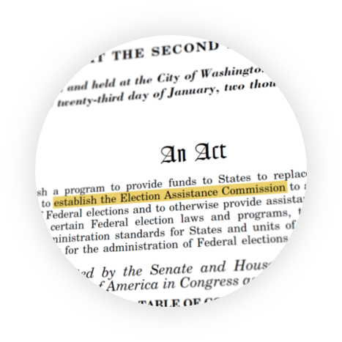


Help America Vote Act of 2002
During the 2000 presidential election, the close margin between George W. Bush and Al Gore in Florida triggered a recount
Landmark Supreme Court Bush v. Gore
Led to the Help America Vote Act (HAVA) and the establishment of the EAC
Notes:
The Election Assistance Commission, or EAC, was established in the aftermath of the 2000 presidential election and the Supreme Court case Bush v. Gore to settle the Florida recount dispute.
The close margin between George W. Bush and Al Gore in Florida triggered a recount, and at issue in the Supreme Court case was how to determine the “clear intent of the voter."
Florida election officials were offered little guidance on ballot counting, leading to recount rules that were vague, inconsistent, and varied county to county.
The controversy led to the enactment of the Help America Vote Act, or HAVA, and the establishment of the EAC as the only federal agency solely focused on helping to improve election administration across the country.
HAVA is the first time it was written in federal law that voters with disabilities should have the same opportunities to vote privately and independently.

Slide 3



About the EAC
Independent, bipartisan Commission established by the Help America Vote Act (HAVA).
ELECTION ADMINISTRATORS
Adopts voluntary voting system guidelines, certifies
voting systems and accredits testing laboratories.
Serves as a national clearinghouse of information on election administration.
Distributes, administers, and audits the use of HAVA funds.
VOTERS
Maintains the National Mail Voter Registration Form.
Notes:
The U.S. Election Assistance Commission helps election officials improve the administration of elections and helps Americans participate in the voting process.
To fulfill our mission, the EAC has 4 main buckets of work:
Developing voluntary voting system guidelines;
Testing and certification of voting systems;
Administering HAVA funding; and
Serving as a national clearinghouse of election administration information.

Slide 4
Our Mission
The U.S. Election Assistance Commission helps election officials improve the administration of elections and helps Americans participate in the voting process.
Notes:
All of this can be summed up in our mission to help election officials improve the administration of elections and help Americans participate in the voting process.

Slide 5

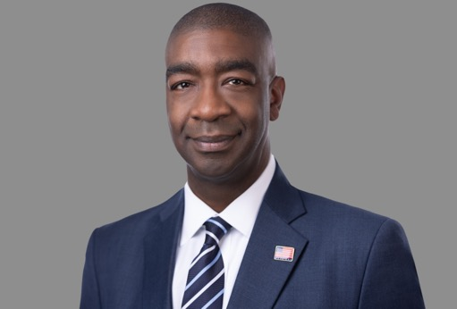

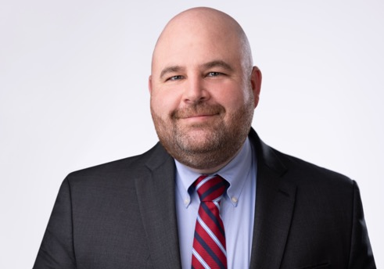
Leadership
Donald Palmer
CHAIRMAN
Thomas Hicks
VICE CHAIR
Christy McCormick
COMMISSIONER
Ben Hovland
COMMISSIONER

Slide 6


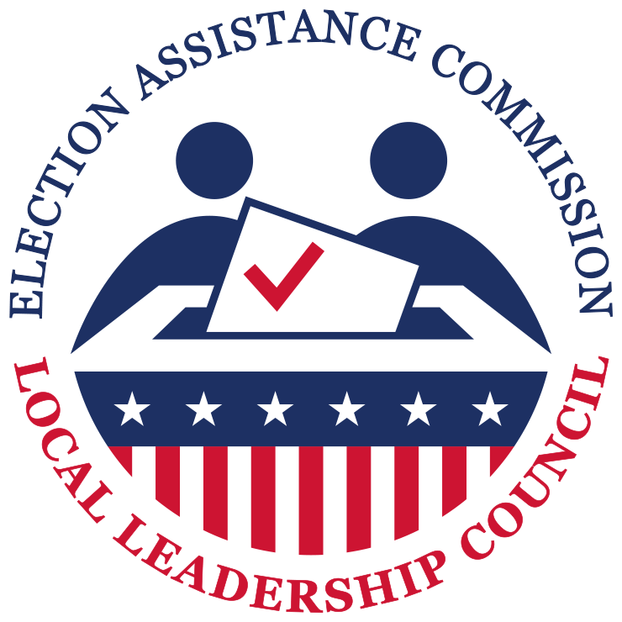
EAC Advisory Boards
Standards Board
Gabe Rosenberg, Chief of Staff & General Counsel, Secretary of State
Marianne Byrne, Registrar of Voters, Town of Prospect
Local Leadership Council
Matthew R. Katra, Registrar of Voters, Borough of Naugatuck
Antoinette C. Spinelli, Town Clerk, City of Waterbury
Notes:
The EAC also has 4 advisory boards, made up of elections officials, technical experts, federal partners, and other elections stakeholders.​
These boards provide valuable feedback to inform and guide the work of the Commission.​
Connecticut election officials are represented Standard Board and LLC, including 2 of your own, Marianne Byrne and Matthew Katra.

Slide 7
EAC Clearinghouse
Notes:
A mentioned above, one of the bucks is serving as a national clearinghouse of election administration information

Slide 8



What is the Clearinghouse?
The U.S. Congress first created a National Clearinghouse for Information on the Administration of Elections within the General Accounting Office (GAO) in 1971
Gather, share, and analyze best practices in election administration
Facilitate peer-to-peer communication among election officials
Notes:
The EAC Clearinghouse of Subject Matter Experts, at it currently exists was recently established as a stand-alone division in 2021. However, the concept of a National Clearinghouse of Election Information dates back to 1971.
For background, a "clearinghouse" can broadly be defined as a central agency for the collection and distribution of information.
As you all know, election administration varies from state to state - in technology, funding structures, deadlines, and even who’s in charge. Some variation also exists within states. This decentralization allows for innovation, and successful best practices that can then spread.

Slide 9
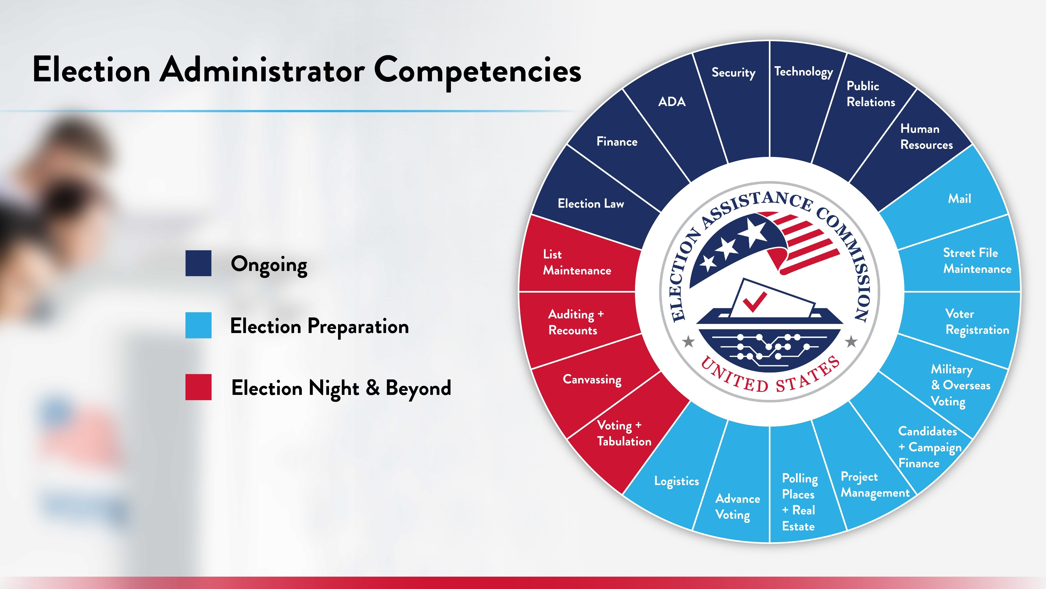
Election Administrator Competencies
Ongoing
Election Preparation
Election Night & Beyond
Notes:
Election Administrators have a lot on their plate.
The Clearinghouse Division does their best to address all of these issues and more

Slide 10


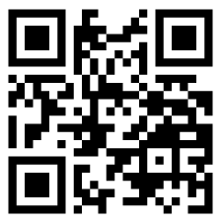
Learning Lab
On-Demand Training for Election Officials
Short video trainings available any time online in the Learning Lab platform
Practical strategies & best practices designed to complement state training
Variety of topics including:
Accessibility
Communications
Poll Worker Training
Election Office Administration
Federal Election Laws
eac.gov/LearningLab
Notes:
The "Learning Lab" is the EAC's new, on-demand training platform for local election officials
The lab is open to all election officials and staff
Videos focus on practical tools and strategies for common challenges election administrators face (things like: accessibility, poll worker training, logic and accuracy testing)
Trainings are short, no longer than 20 minutes each, and share ideas and inspiration, not a prescription for how to do things
Learning Lab content is designed to complement existing state trainings, not replace them - we will always defer to the states for state-specific rules and procedures
We are actively seeking election officials to join the platform and start training

Slide 11
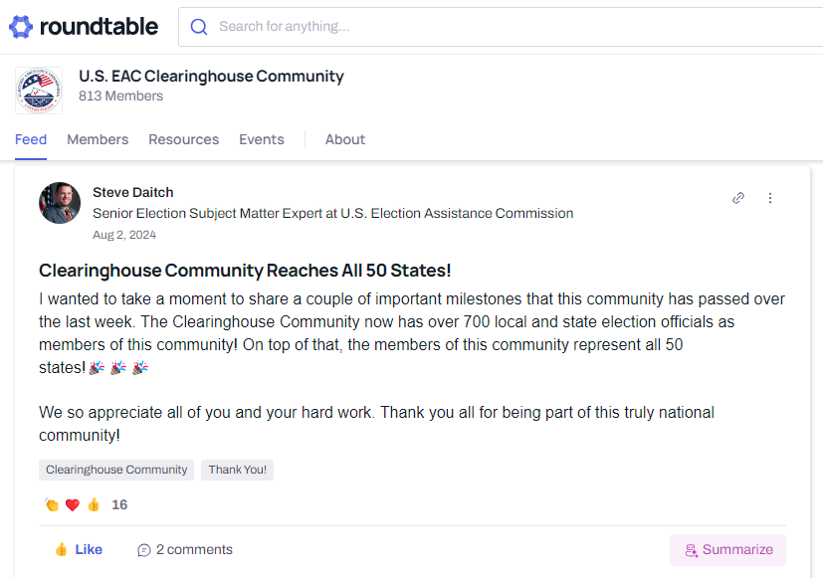


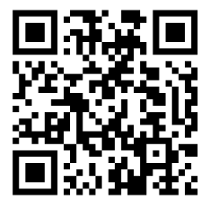

Join the Clearinghouse Community
Dedicated space only for
election officials
Connect with peers across the country
Share knowledge, resources
and ask questions
Access Election Assistance
Commission resources easily
eac.gov/Community
Notes:
If you are not signed up already, please join the Clearinghouse Community!
The EAC Clearinghouse Community is a dedicated space for local, state, and national election administrators to connect with one another.
This is a space for election officials, only.
It’s a place where you can share knowledge, resources, ask questions, and discuss your work with peers from across the country.
The Community is also a quick and easy way to access EAC resources and talk with subject matter experts.
All communities on the Clearinghouse Network are hosted on the Civic Roundtable platform, which you may already be familiar with.
Use the QR code here to create your account.

Slide 12
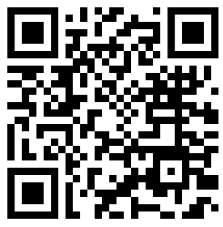
Clearinghouse Resources
Accessibility
Audits
Election Security
In-Person Voting
Language Access
Results, Canvass, and Certification
Training
Voter Information and Communications
Voting Technology
www.eac.gov/election-officials
Notes:
All of the EAC resources are on our website, eac.gov.
To highlight a few of our resources over the past year, materials focused on communications and incident response resources.
These included customizable, easy-to-use materials such as a voter education toolkit, social media toolkit, and guide with CISA to help jurisdictions develop a communications plans and outreach materials.
In response to the hurricanes that hit the Southwest, created a disaster relief resource page that will have information about how states can use HAVA funds, our available Clearinghouse resources, and state and federal contact links.
A 6-part civic education video series called “Be Election Ready" to help eligible voters navigate the election process from registering to vote and making a voting plan; to understanding the different ways of voting by mail or in-person; and the importance of trusted information and the complexities of reporting and certifying election results.

Slide 13
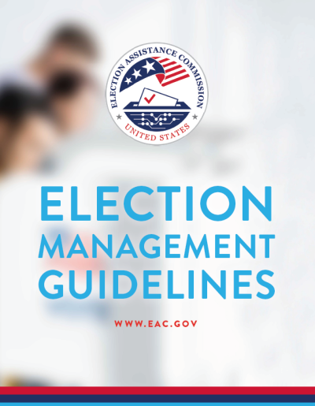
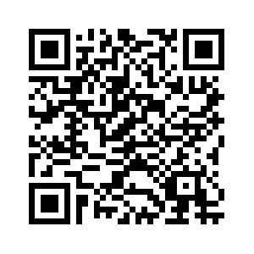
Election Management Guidelines
Training resource for new and experienced election officials
For all election offices, regardless of jurisdiction size or resources
Uses input from local and state election officials and other stakeholders
eac.gov/election-officials
Notes:
The second edition of the EAC’s Election Management Guidelines covers 19 chapters on topics such as accessibility and voting system certification, for new and experienced election officials regardless of their jurisdiction size or resources.
This update includes a new chapter on Post-Election Audits and relevant elections technologies are discussed throughout the new EMG
You can use this QR code to view the updated EMG on our website.

Slide 14
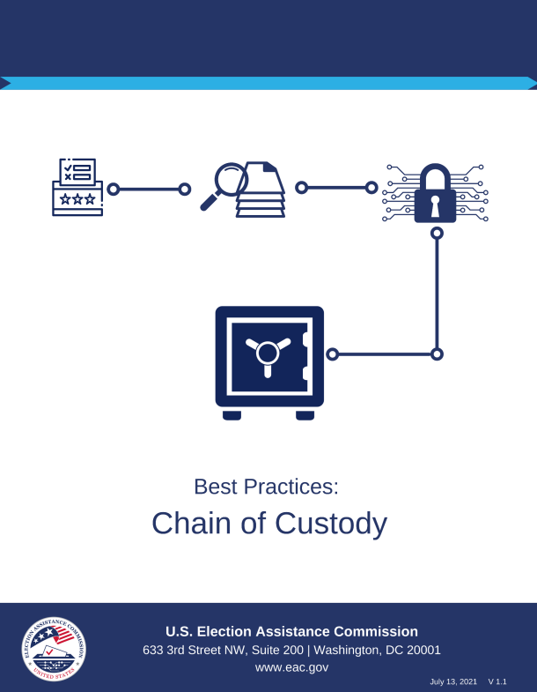

Chain of Custody
Election officials can track the movement and transportation of ballots, voting machines, and other election materials through witnesses, signature logs, security seals, video, etc.
A break in the chain of custody increases the risk that the integrity or reliability of the asset cannot be restored.
Notes:
Ensuring chain of custody procedures throughout the election audit process is paramount
Chain of custody is a process used to track the movement and control of an asset through its lifecycle by documenting each person and organization who handles an asset, the date/time it was collected or transferred, and the purpose of the transfer
Offices should develop appropriate activities to implement in response to a detected breach of the chain of custody. Response measures allow the organization to determine the impact and consequences of the breach.
For more information please visit Chain of Custody Best Practices at eac.gov

Slide 15
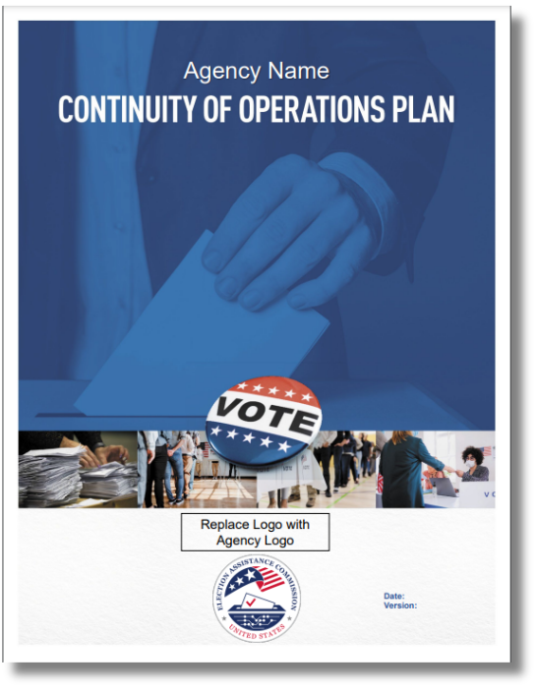
Continuity of Operations Plan (COOP)
Customizable COOP Template
COOP Template Guidance
“How To” Video
Additional resources can be found at: www.eac.gov/election-officials/contingency-planning
Notes:
Our COOP resources were developed with the help of FEMA to help jurisdictions think through a variety of different emergency situations including cybersecurity issues.
All hazards – it’s not a collection of plans for every different circumstance, fire, hurricane, power outage, disturbance, but one plan that’s responsive to any scenario where you may lack access, staff, and resources.
To help election officials complete the template and think through their office operations, we also released an accompanying guidance document and How-To-Video.
As seen in the recent elections having these plans in place proved invaluable in a variety of situations and locations

Slide 16
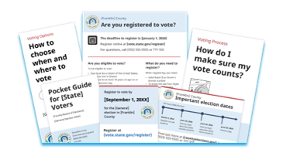
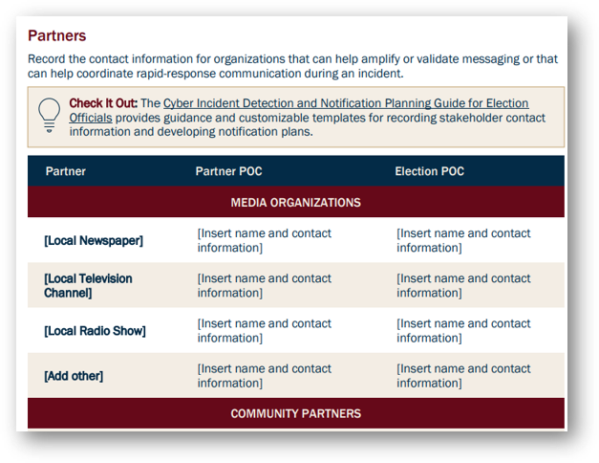
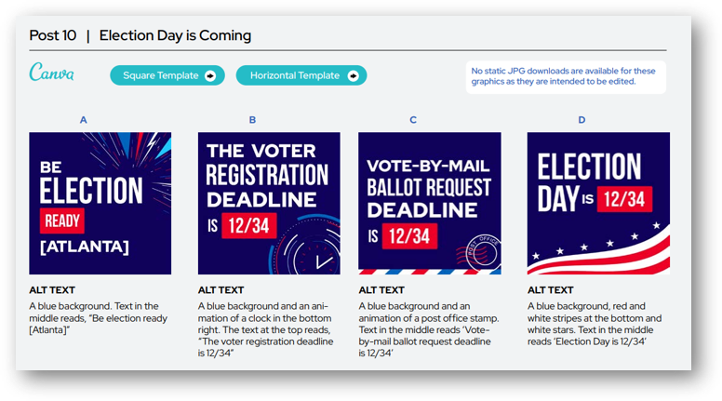

Communication Guidelines
Social Media Toolkit
Election Security Public Communications Guide
Voter Education Toolkit
…and more!
Notes:
We have a voter education toolkit, social media toolkit, and guide with CISA to help you develop a communications plans and outreach materials.
Many of the communications guidelines come with tool kits that all allow election offices without much communications support to easily create jurisdiction-specific communications

Slide 17

Upcoming 2024 EAVS
Supports data-driven policy solutions to improve areas such as:​
  Military and overseas voting​
  Voting accessibility​
  Mail-in voting​
  Registration ​
  Poll worker recruitment ​
The EAVS report will be published in Summer 2025.
Notes:
The Election Administration and Voting Survey creates the nation’s most comprehensive report on federal election administration, registration and voting on the federal, state and local levels.
The 2024 EAVS report will be published in Summer 2025.
We are also looking at doing off-year election surveys to help supplement our election year surveys
The Policy survey collects information on state election laws, policies and practices:​
Election infrastructure​
Voter registration and list maintenance​
Election technology​
Mail, In-person, UOCAVA, and provisional voting​
Election certification, recounts, and audits​
Voting Equipment Usage​
Poll Workers, Polling Places, and Precincts

Slide 18

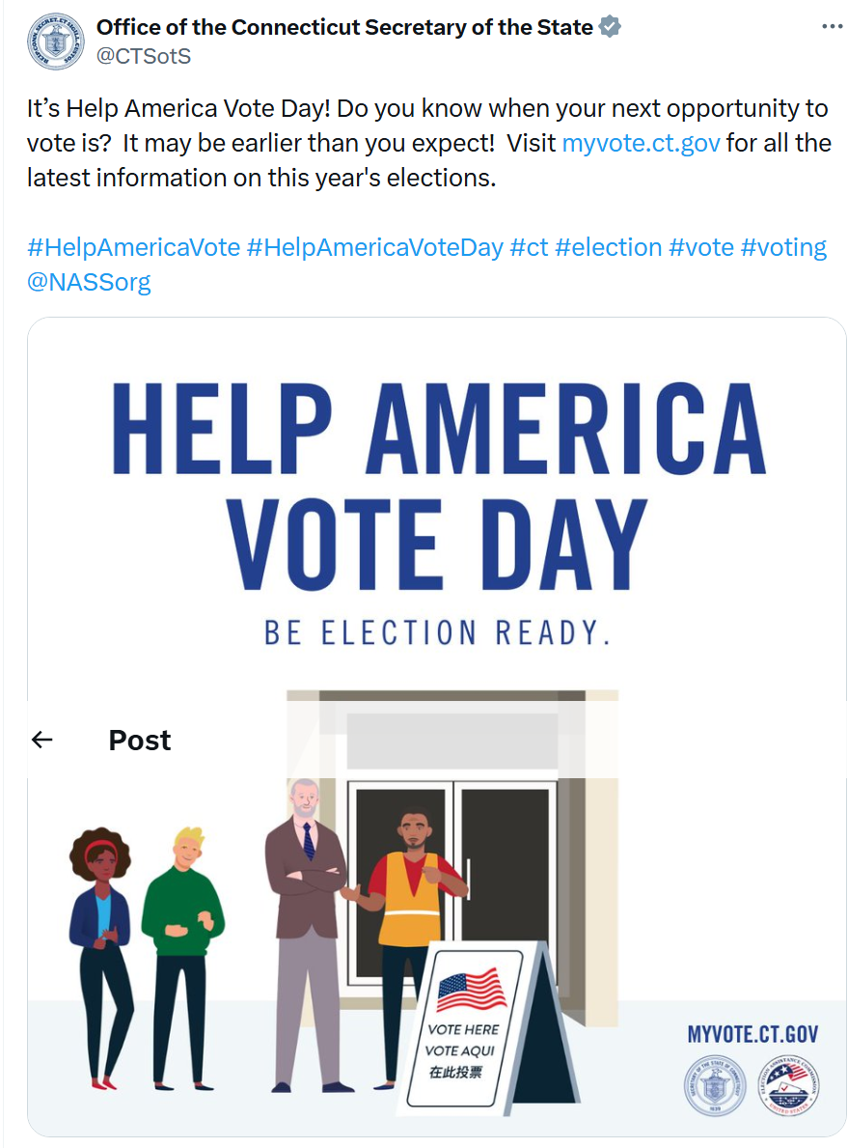
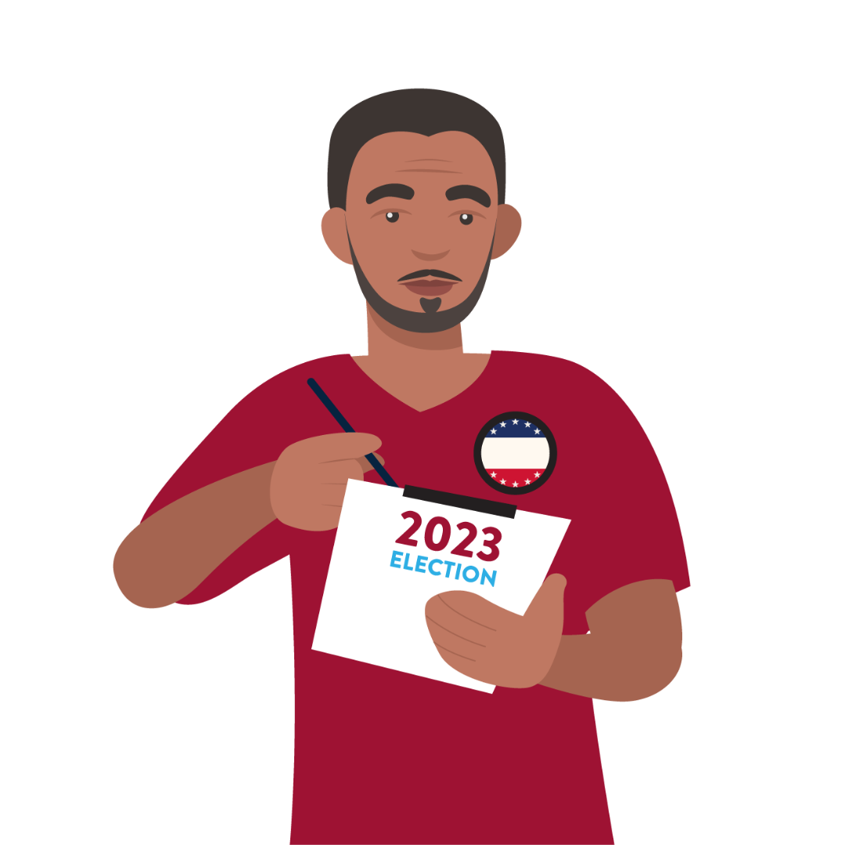
National Poll Worker Recruitment Day
AUGUST 12, 2025
Notes:
To further help you prepare for your elections, the EAC is hosting our annual National Poll Worker Recruitment Day on August 12.
We most recently had another day of action, Help America Vote Day, where we had offices from 37 states (including Connecticut) plus Guam and DC participate.
Here is an example from the Secretary of State’s office.
Thank you to all of you who have participated and made these days of action a success over the last several years! We’ve loved seeing all of the engagement generated with voters and the public.

Slide 19

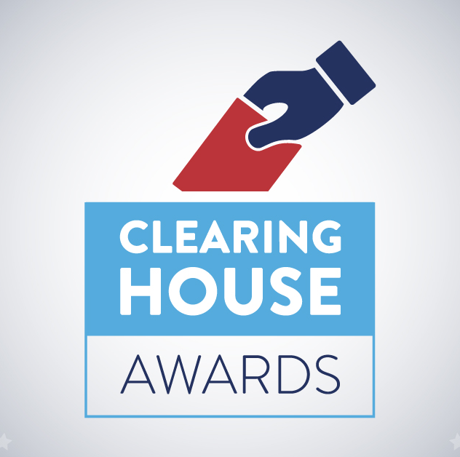
National Clearinghouse Awards
The Clearinghouse Awards, or “Clearie” Awards, celebrate innovation and best practices in election administration across the country.
Look for winners to be announced this spring!
eac.gov/clearies
Notes:
In April, we will be announcing our 2024 “Clearie” Awards.
These awards recognize best practices in election administration from the 2024 election.

Slide 20

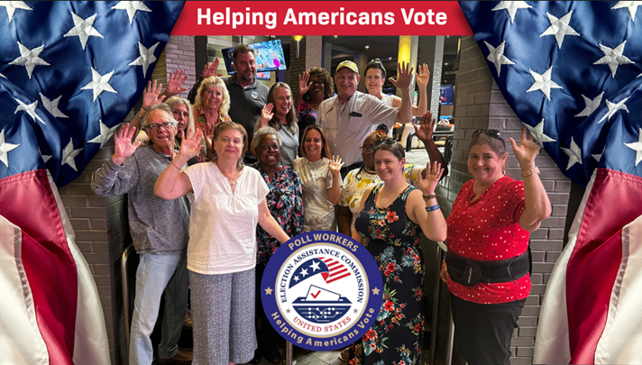
Poll Workers Helping Americans Vote
Social media campaign highlighting poll workers' importance to the nation
Looking for group photos of poll workers excited to participate in the general election
EAC will provide a toolkit with instruction on how to customize artwork for social media that users can adapt for other purposes as needed
Notes:
EAC is creating a National Social Media Campaign to Highlight the Importance of Poll Worker to the Nation.
Social media images created can be shared by all election stakeholders including participating poll workers and will become part of the EAC's creative social media

Slide 21
EAC Testing and Certification
Notes:
The next 3 buckets of work are encompassed by our testing and certification program

Slide 22
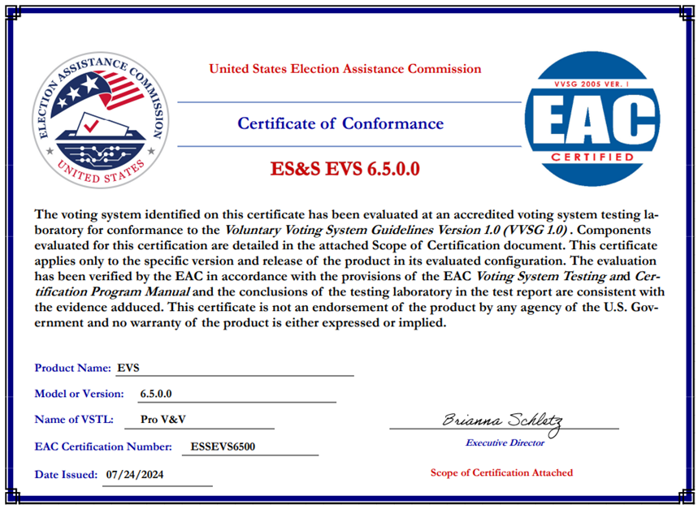
Voluntary Voting System Guidelines (VVSG) 2.0
Three Systems Currently Under Testing:
Smartmatic VSR1 2.1
Harty Verity Vanguard 1.0
Voting Works VxSuite 4.0
Notes:
As part of our Testing and Certification program, the EAC is charged with developing Voluntary Voting System Guidelines, or VVSG, to help make election systems more secure.
These guidelines are completely voluntary; however, some states do require adherence to VVSG by law.
The original VVSG started with version 1.0. The EAC recently adopted higher standards for voting systems in 2021 – known as the VVSG 2.0 and increase increases transparency, security, accuracy, accessibility
These systems are paper based allowing for better audibility
While systems that are certified to VVSG 1.0 will remain certified, new voting systems certified by the EAC will be required to adhere to the higher standards in VVSG 2.0.
We have 3 2.0 systems in the test case development stages and at varying locations with new drops, source code review, documentation review, and hardware testing completion

Slide 23



Election Supporting Technology Evaluation Program (ESTEP)
Election Supporting Technology Evaluation Program (ESTEP)
FUNCTIONALITY
SECURITY
ACCESSIBILITY
Usability Features
Functional Configuration
Compatibility
Telecommunications
System Maintenance & Troubleshooting
Access Control
Physical Security Measures
System Integrity
Network/Telecommunications Security
Software Design & Architecture
Supply Chain Risk Management
Baseline Accessibility
Supporting Visual Features
Supporting Physical Features
Supporting Audio Features
Additional Languages
Questions? Contact ESTEP@eac.gov
Notes:
ESTEP stands for “Election Supporting Technology Evaluation Program​.”
The program evaluates the security, accessibility and functionality of election supporting technologies such as e-poll books, electronic ballot delivery, voter portals and election night reporting systems.
Through ESTEP, we aim to:​
Produce election technology standards similar to VVSG​
Create draft standards that can be used by Voting System Testing Laboratories, or VSTLS​
Create program manuals ​
Administer and report results of pilot programs ​

Slide 24

ESTEP Pilot Program Timelines
Electronic Ballot Delivery
Pilot Program
Election Night Reporting
Pilot Program
Voter Registration Systems
Pilot Program
  Timeline – Pilot program launch mid-April 2025
  Current Phase – Developing requirements with stakeholder feedback
  Timeline - Pilot program launch June 2025
  Current Phase – Developing requirements with stakeholder feedback
  Timeline – Expected pilot program launch in Late 2025 or early 2026
Notes:
Now that the agency has formally adopted the e-poll book program, the current technologies ESTEP is examining are:
The Electronic Ballot Delivery Pilot was launched in mid-2024;
[FYI: Ballot delivery systems are used for the electronic delivery of ballot and voter information packets to UOCAVA voters. Some jurisdictions also offer electronic ballot delivery to voters with disabilities, voters who have been displaced, or specified unique situations.]
The Election Night Reporting Pilot was launched in late 2024, with added emphasis on accessibility of results reporting webpages; and
[FYI: Election night reporting software facilitates the collection, aggregation, reporting, and secure sharing of unofficial election results to the public.]
ESTEP is planning on launching their next pilot program focusing on Voter Registration Systems in early 2025.
[FYI: Voter registration systems can be defined as a combination of either hardware, software, or firmware, materials, and documentation used to automate the process of voter registration and secure voter information within a county, state, or election jurisdiction by election administrators.]
The hope with this is also to create a level of data standardization to allow better communication between the states and other sources for list maintenance
If you have any technologies that you would like to be a part of these pilot programs, please let us know.

Slide 25
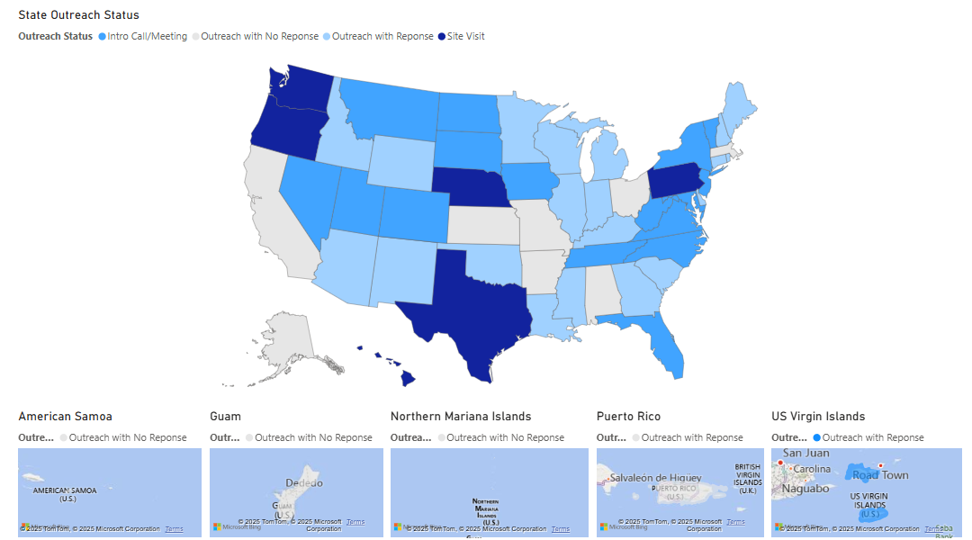
Field Services Program
Assists With:
Hash Verification
Fielded System Reviews
Anomalies
Manufacturer Audits
Notes:
Another program we’re excited about is our Field Services Program, a new and proactive outreach initiative.​​
While engaged with state and local election offices either virtually or on-site, it is also our objective to be a proactive Clearinghouse resource, and to offer best practices training to support wherever possible.​​
In this picture, you see our internal tracking tool giving you all a visual on the level of outreach in the first full year of the program. You might have heard from Sean Pumphrey, the Field Service Program representative for the Northeast region.
​​This program will proactively provide a combination of virtual and onsite best practices trainings and services for election offices such as:
Hash Verification: as a hybrid system verification and election security tool, requests from states and locals for assistance with hash verification have seen exponential growth. 84 individual jurisdictions were supported through the FSP in hash verification over the last fiscal year. Hash verification is the best tool we have at our disposal to verify that the election technology you have deployed are precisely as they are certified.
System Reviews: System reviews are key in our ability to reach you, the jurisdictions, when system changes affect you. FSP so far has received overwhelming support from our state and local partners, as well as manufacturers, in fielded system reviews. On more than one occasion and in at least two states, working with the FSP on a system review has expedited a state system acceptance test - and contributed directly to time and budget savings on a current federal certification campaign. This support will continue to grow as the program expands.
Anomalies: during all election cycles this past year, the FSP team has been monitoring for anomalies in election technology. Doing so allows us to respond with an analysis as quickly as possible to questions about systems in use by the public, but also allows us to coordinate public response, and streamlines the distance between a potential system change and our folks here at the EAC – the primary certification body.
Manufacturer Audits: one of FSP’s main goals is to conduct manufacturer audits back to the point of manufacture. This year we’re looking to fulfill this program goal by sending teams to audit quality management systems in place with the country’s vendors – both domestic and overseas operations.

Slide 26
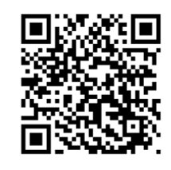
Where to Find EAC Information
Email
clearinghouse@eac.gov
YouTube Channel
@U.S. Election Assistance Commission
Sign up for the EAC Monthly Newsletter on eac.gov:
Facebook
Facebook.com/eacgov1
Instagram
us.eac
X
@EACgov
eac.gov
Notes:
We are constantly rolling out new products to add to already large collection of election resources.
The EAC has a monthly newsletter that includes upcoming events, new resources, and any other relevant information to assist you

Slide 27
Questions?
Notes:
Thank you for allowing us to speak today. If you have any questions concerning what we discussed today or anything else, we will do our best to answer those now.
Since we are an agency that is here to "Assist" is there any product that would be beneficial to you or troublesome issue that you are dealing with that we at the EAC could do delve into to help find solutions?

Slide 28
Contact Information
Thomas Hicks, Vice Chair
Thomas Hicks
thicks@eac.gov
Notes:
Here is my contact information.

Slide 29
THANK YOU
eac.gov

