Slide 1
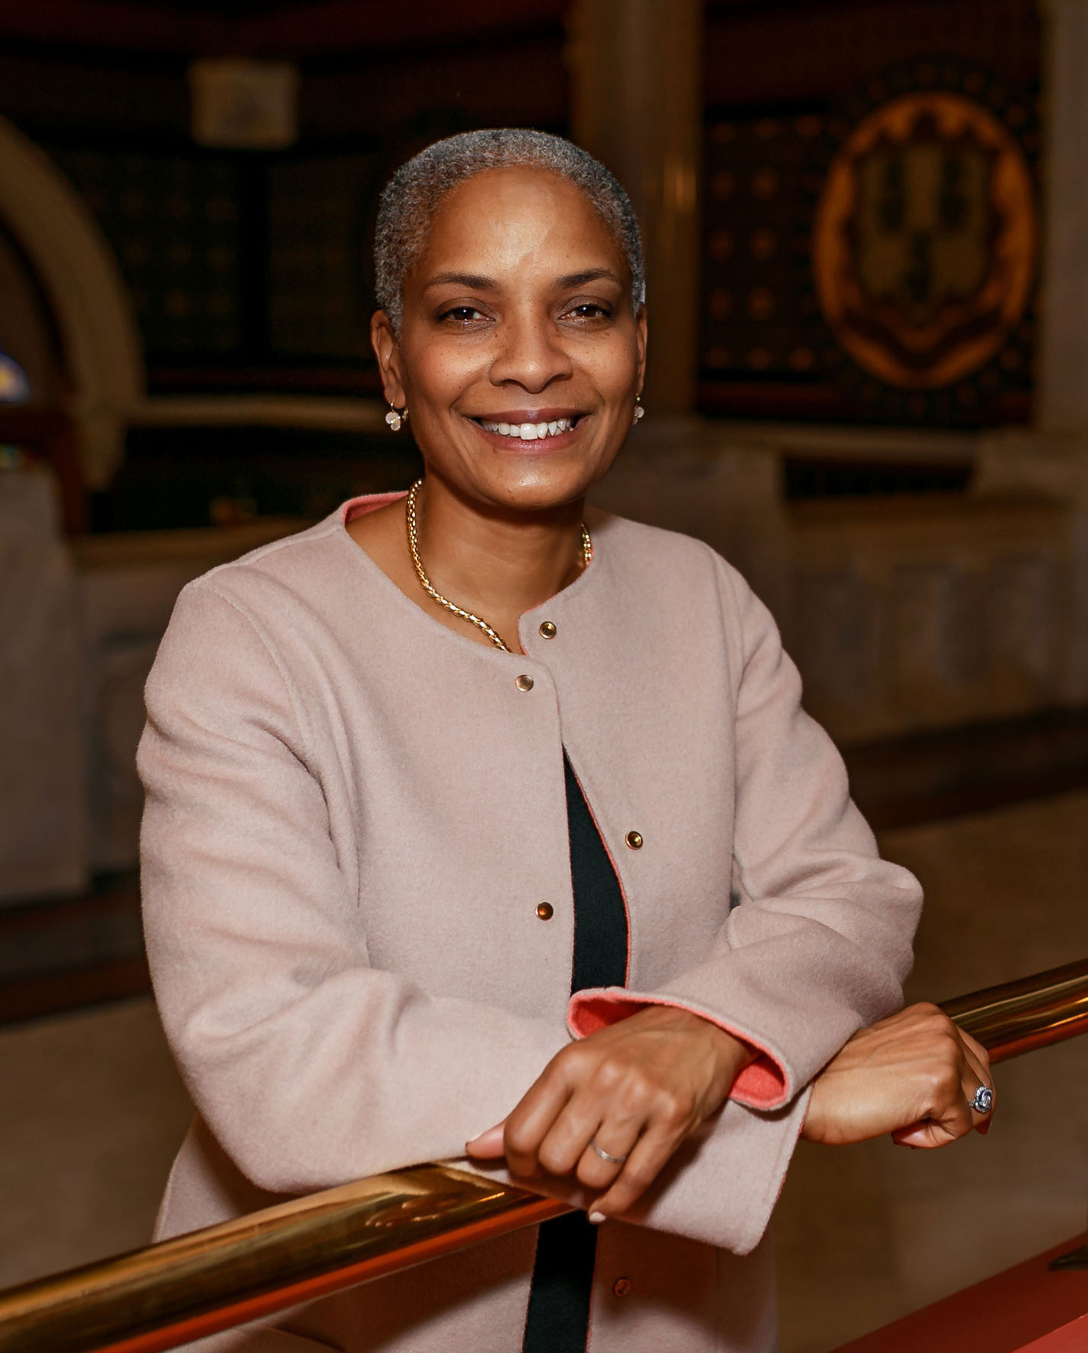
2025 ROVAC
Spring Conference
Office of the Connecticut Secretary of the State

Slide 2
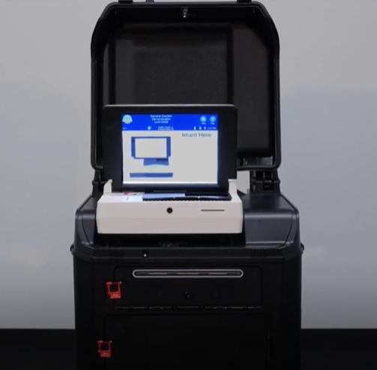
Project Updates
Office of the Connecticut Secretary of the State

Slide 3
Title
Connecticut General Assembly
Tabulator Leases
Universal Absentee Ballots
Early Voting Hours
Funding for Early Voting

Slide 4
Title
Plans for 2025 & 2026
E-pollbooks
Title 9 Review
Training
Poll Workers
Multi-Lingual Services
Bonding Request – Website Update
Recruitment of Next Generation

Slide 5
Next Gen Elections - A Huge Success!
Title
Early Voting
Over 800 hours worked at the polls!
Registrars of Voters felt “Very Confident” utilizing Next Gen students.
Almost 70% of students are “Very Likely” to return to some kind of election work after the program ends.
Over 80% of students reported that the program has motivated them to vote in every election.
Election Day
Same Day Registration

Slide 6
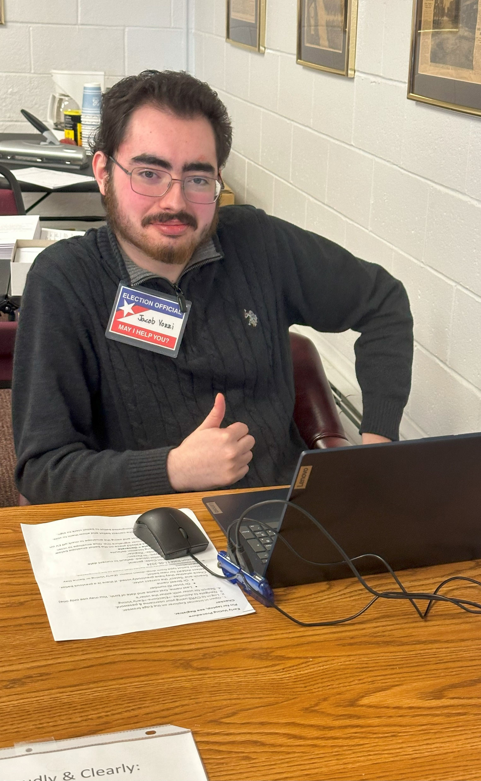
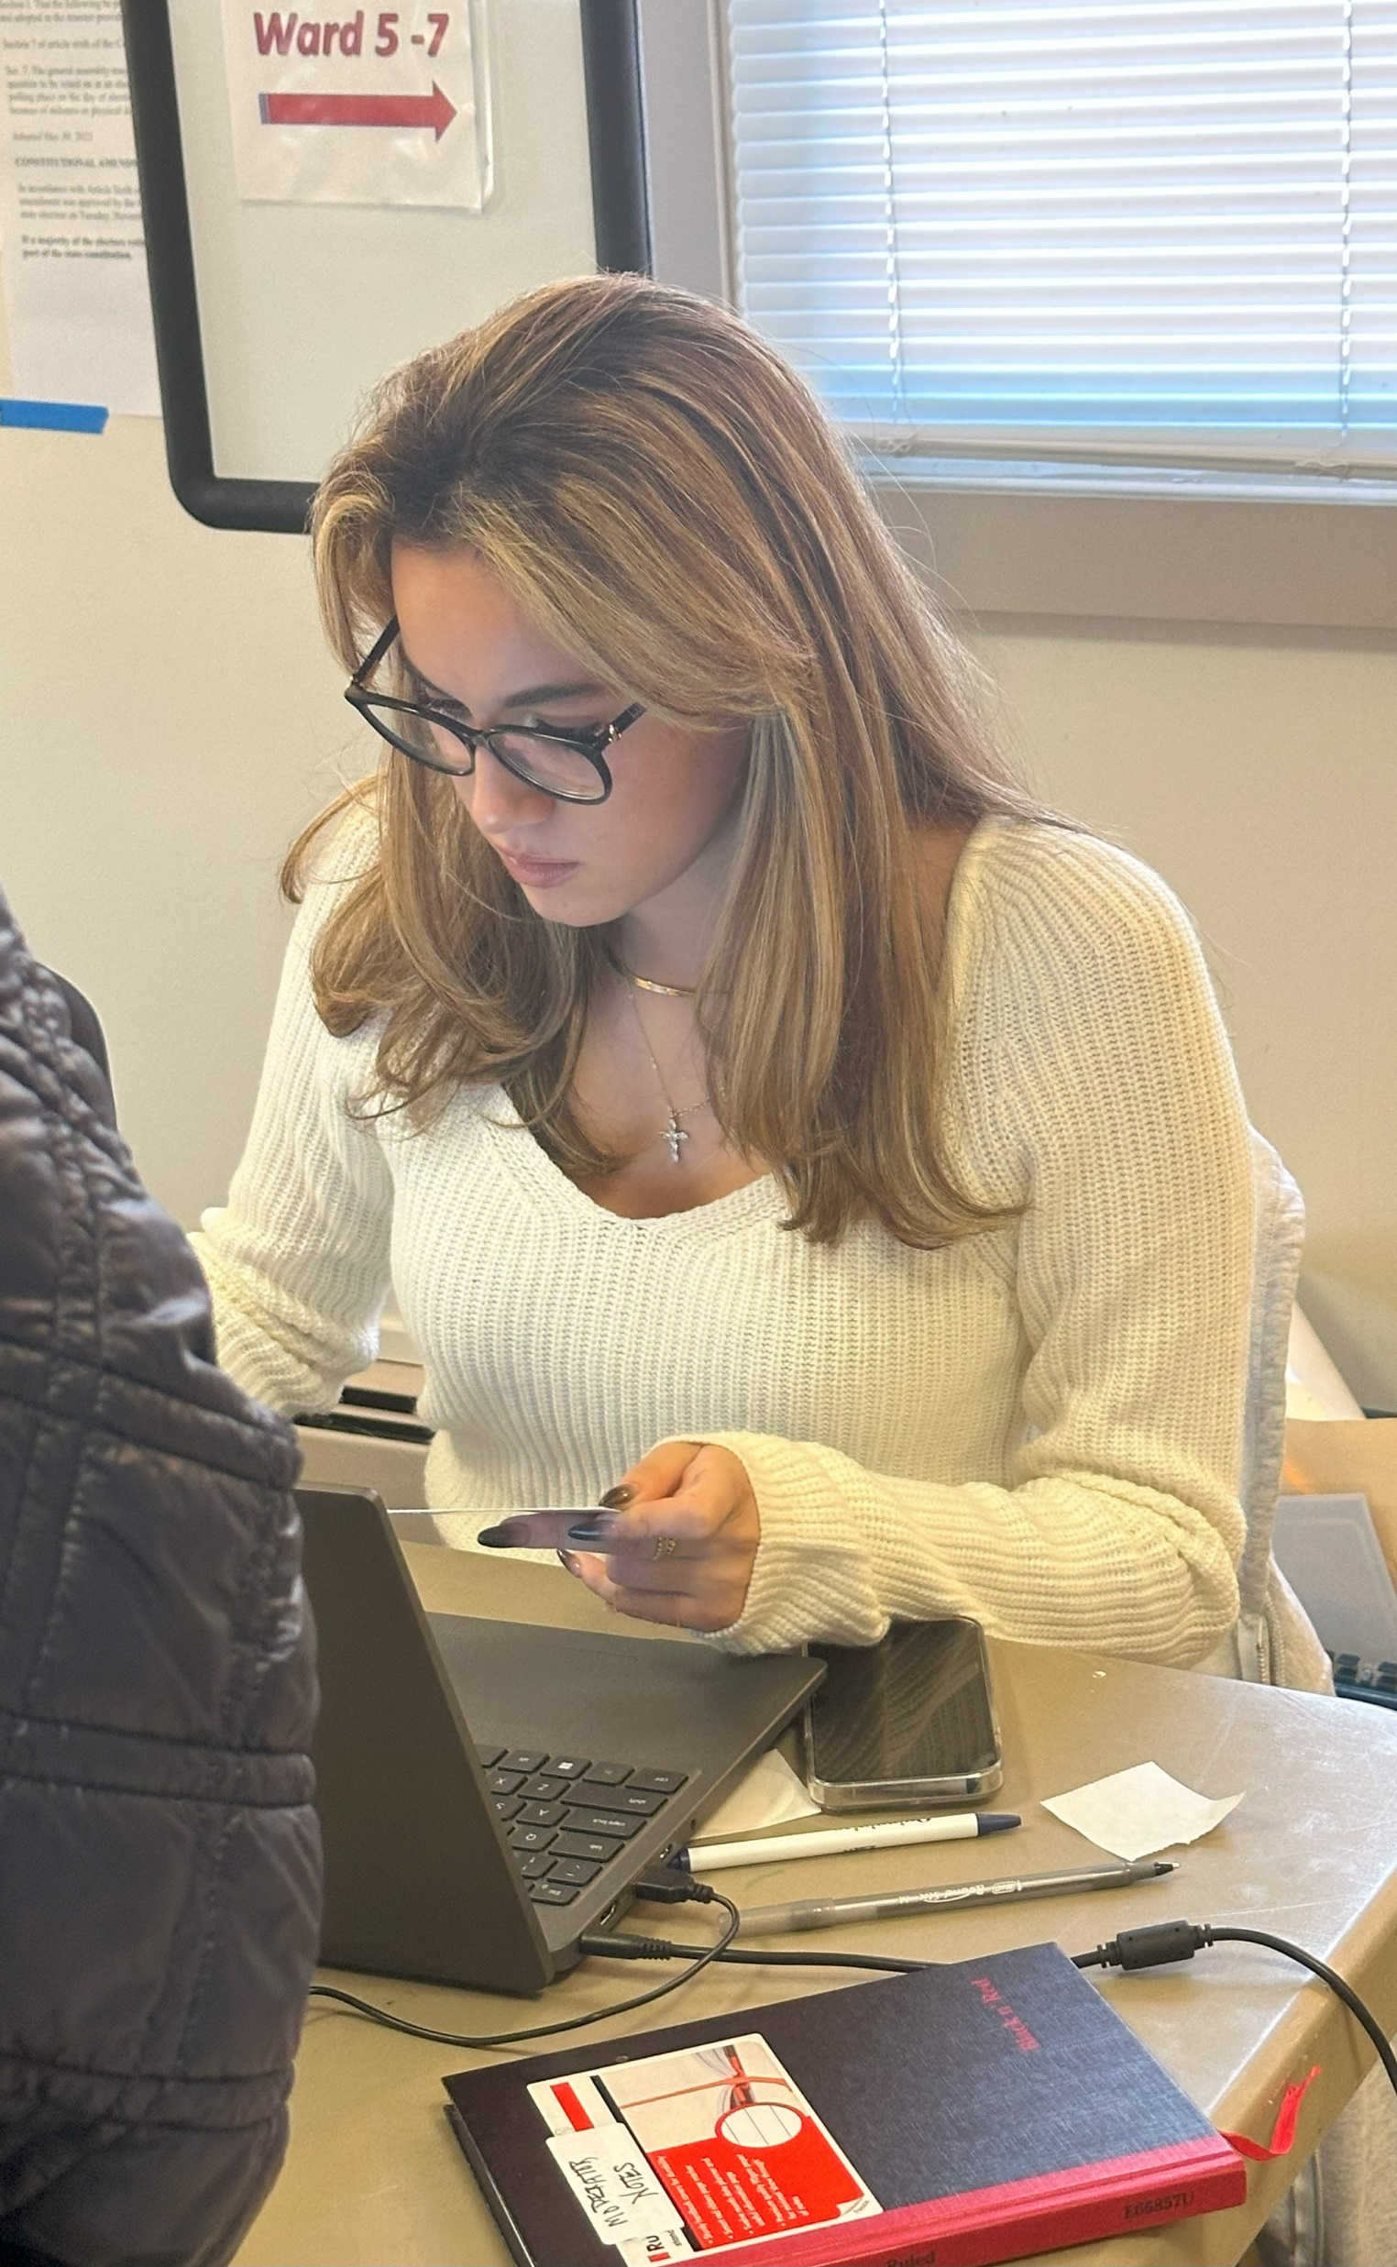
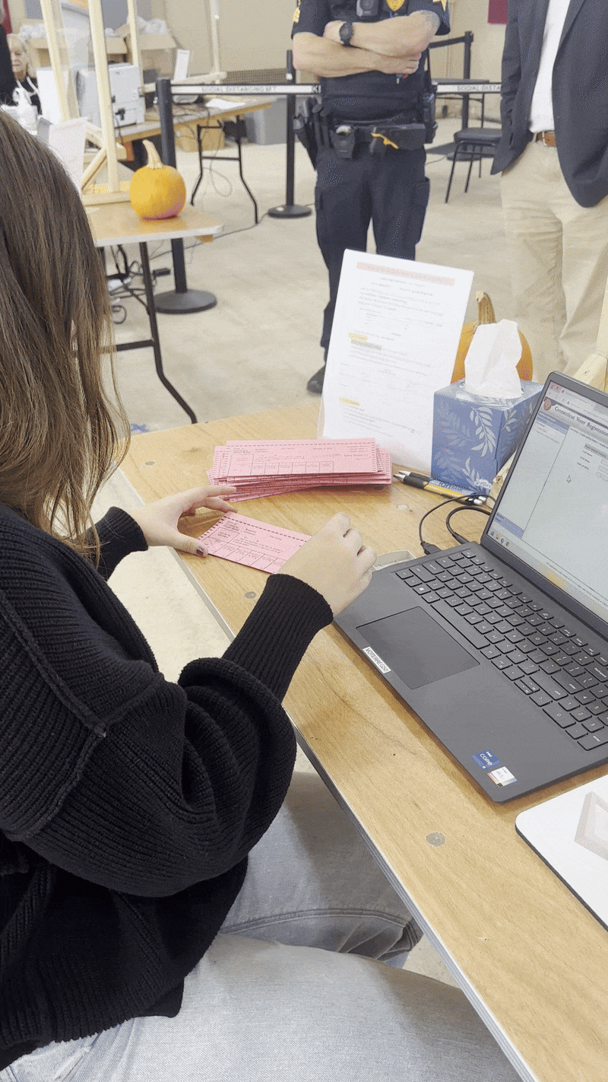
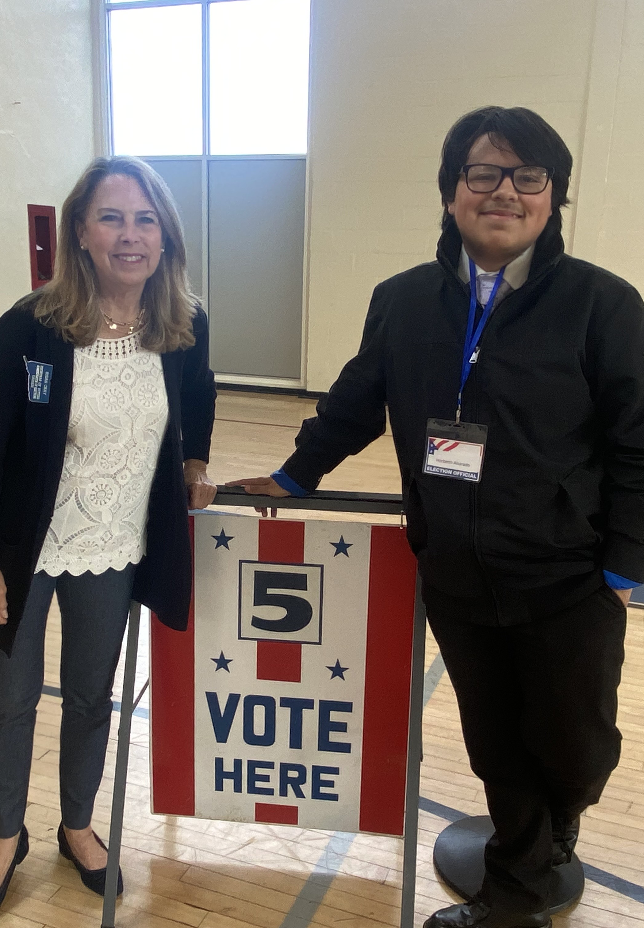
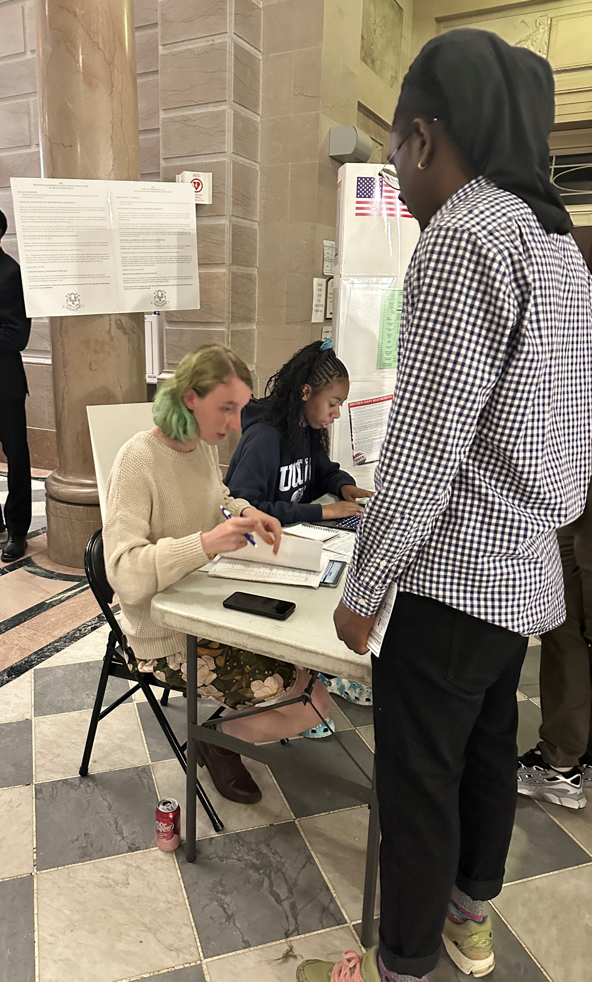
Next Gen Elections – Ready for 2025
Office of the Connecticut Secretary of the State

Slide 7
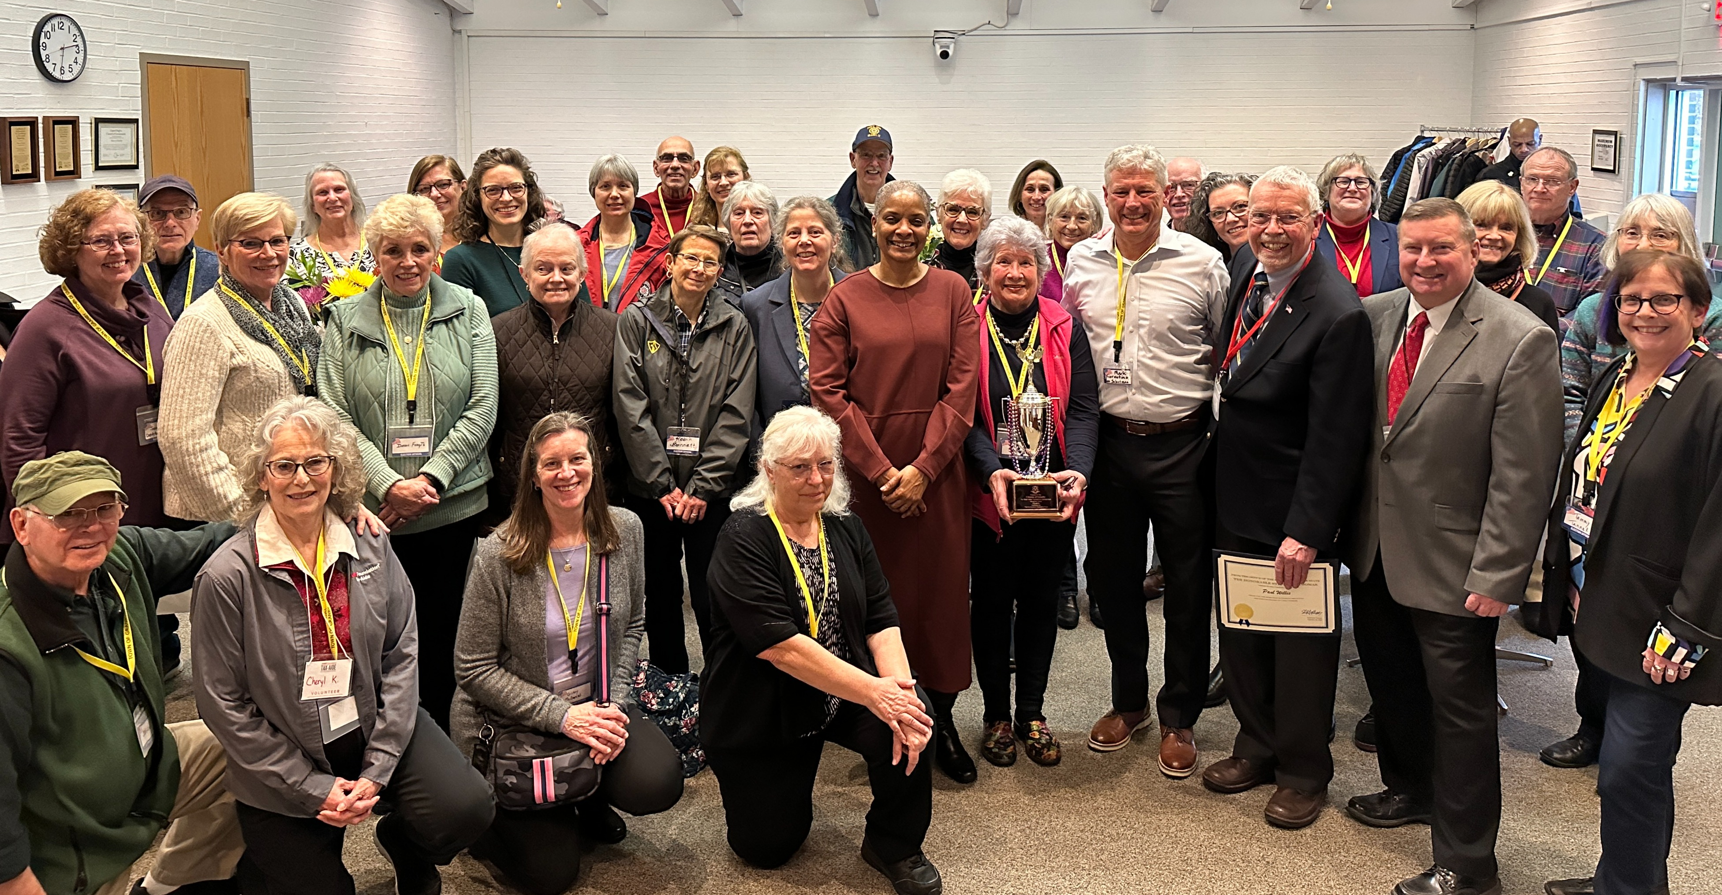
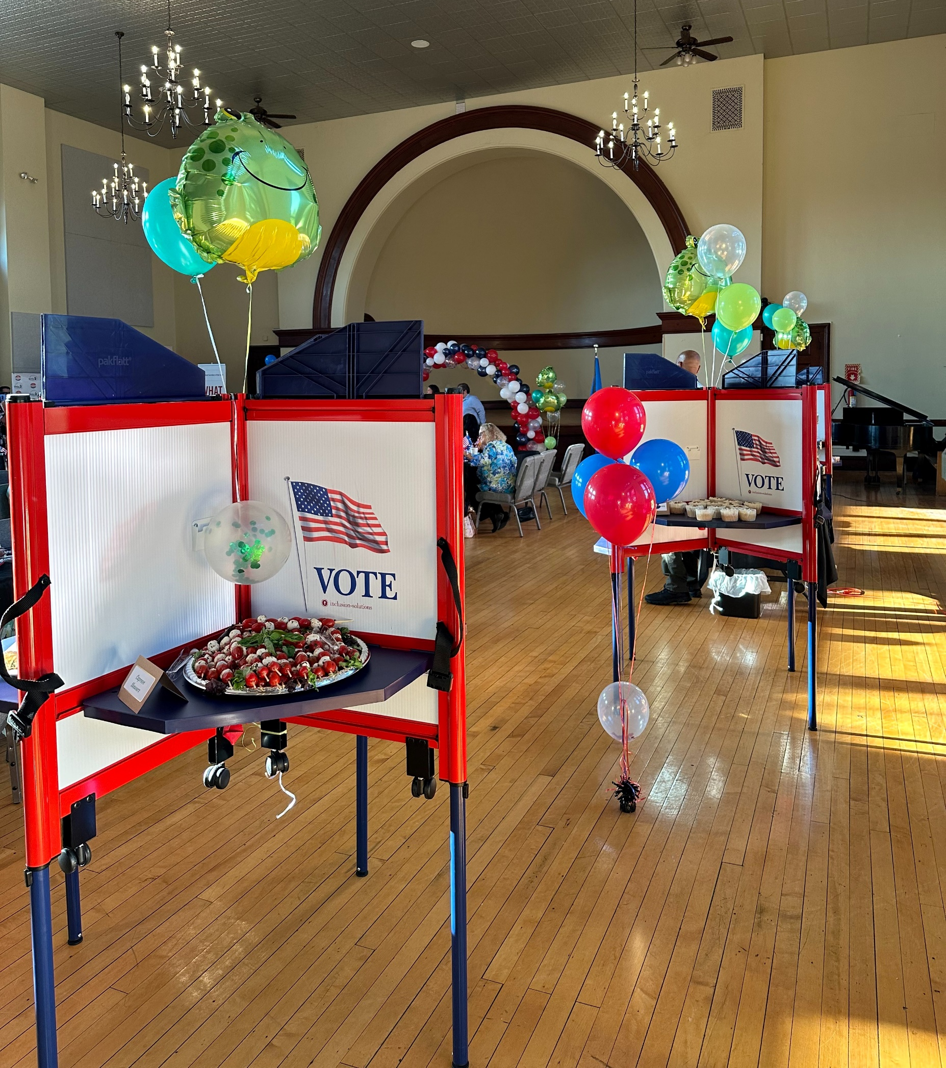
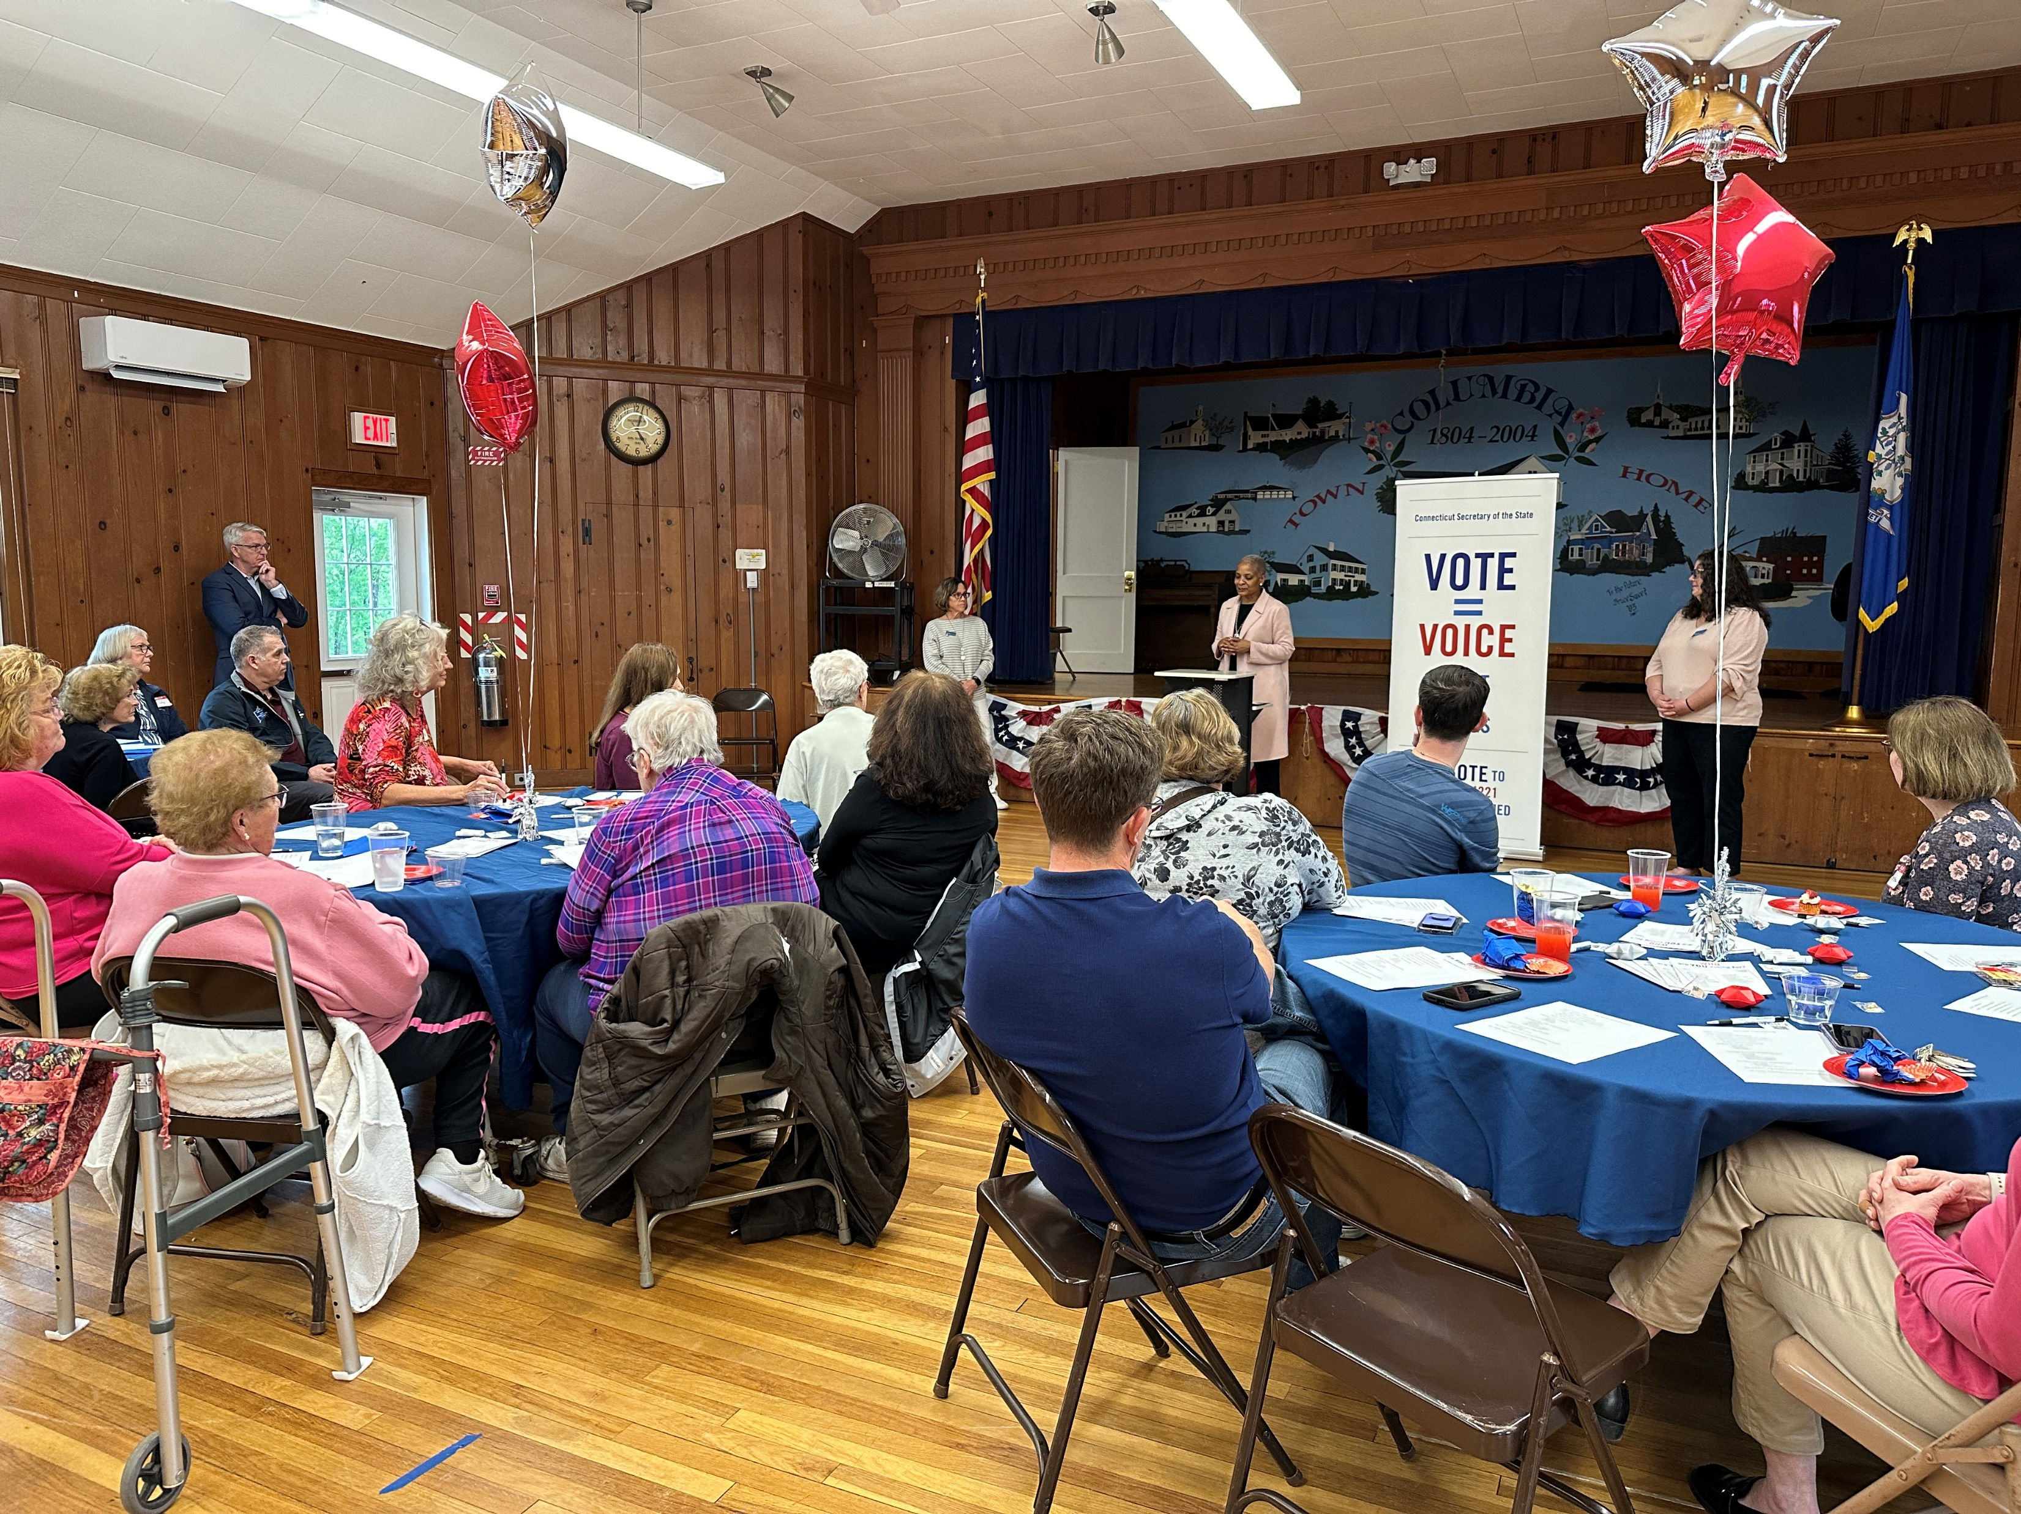
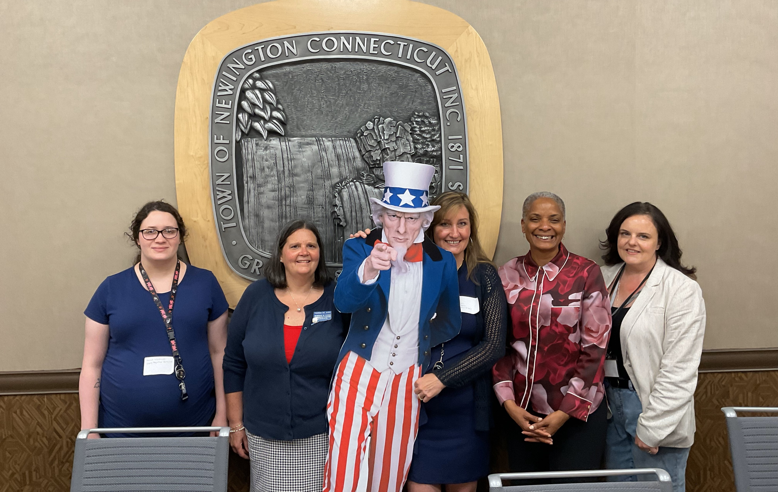
Poll Worker Appreciation Events
Office of the Connecticut Secretary of the State

Slide 8
Poll Worker Appreciation Events – By the Numbers
Title
23 TOWNS VISITED
Bethany
Bloomfield
Columbia
Durham
Fairfield
Granby
Hamden
Litchfield
Madison
Meriden
Milford
Newington
Newtown
Norwalk
Plymouth
Prospect
Redding
Thompson
Willington
Wilton
Windham
Windsor
Woodbridge
685 EVENT ATTENDEES
91 CITATIONS AWARDED
295 CERTIFICATES AWARDED

Slide 9
2024 Democracy Cup Winners
Title
City – Stamford, 73.95% Turnout
Large Town – Fairfield, 84.53% Turnout
Mid-Sized Town – East Hampton, 89.64% Turnout
Small Town – Cornwall, 90.46% Turnout

Slide 10
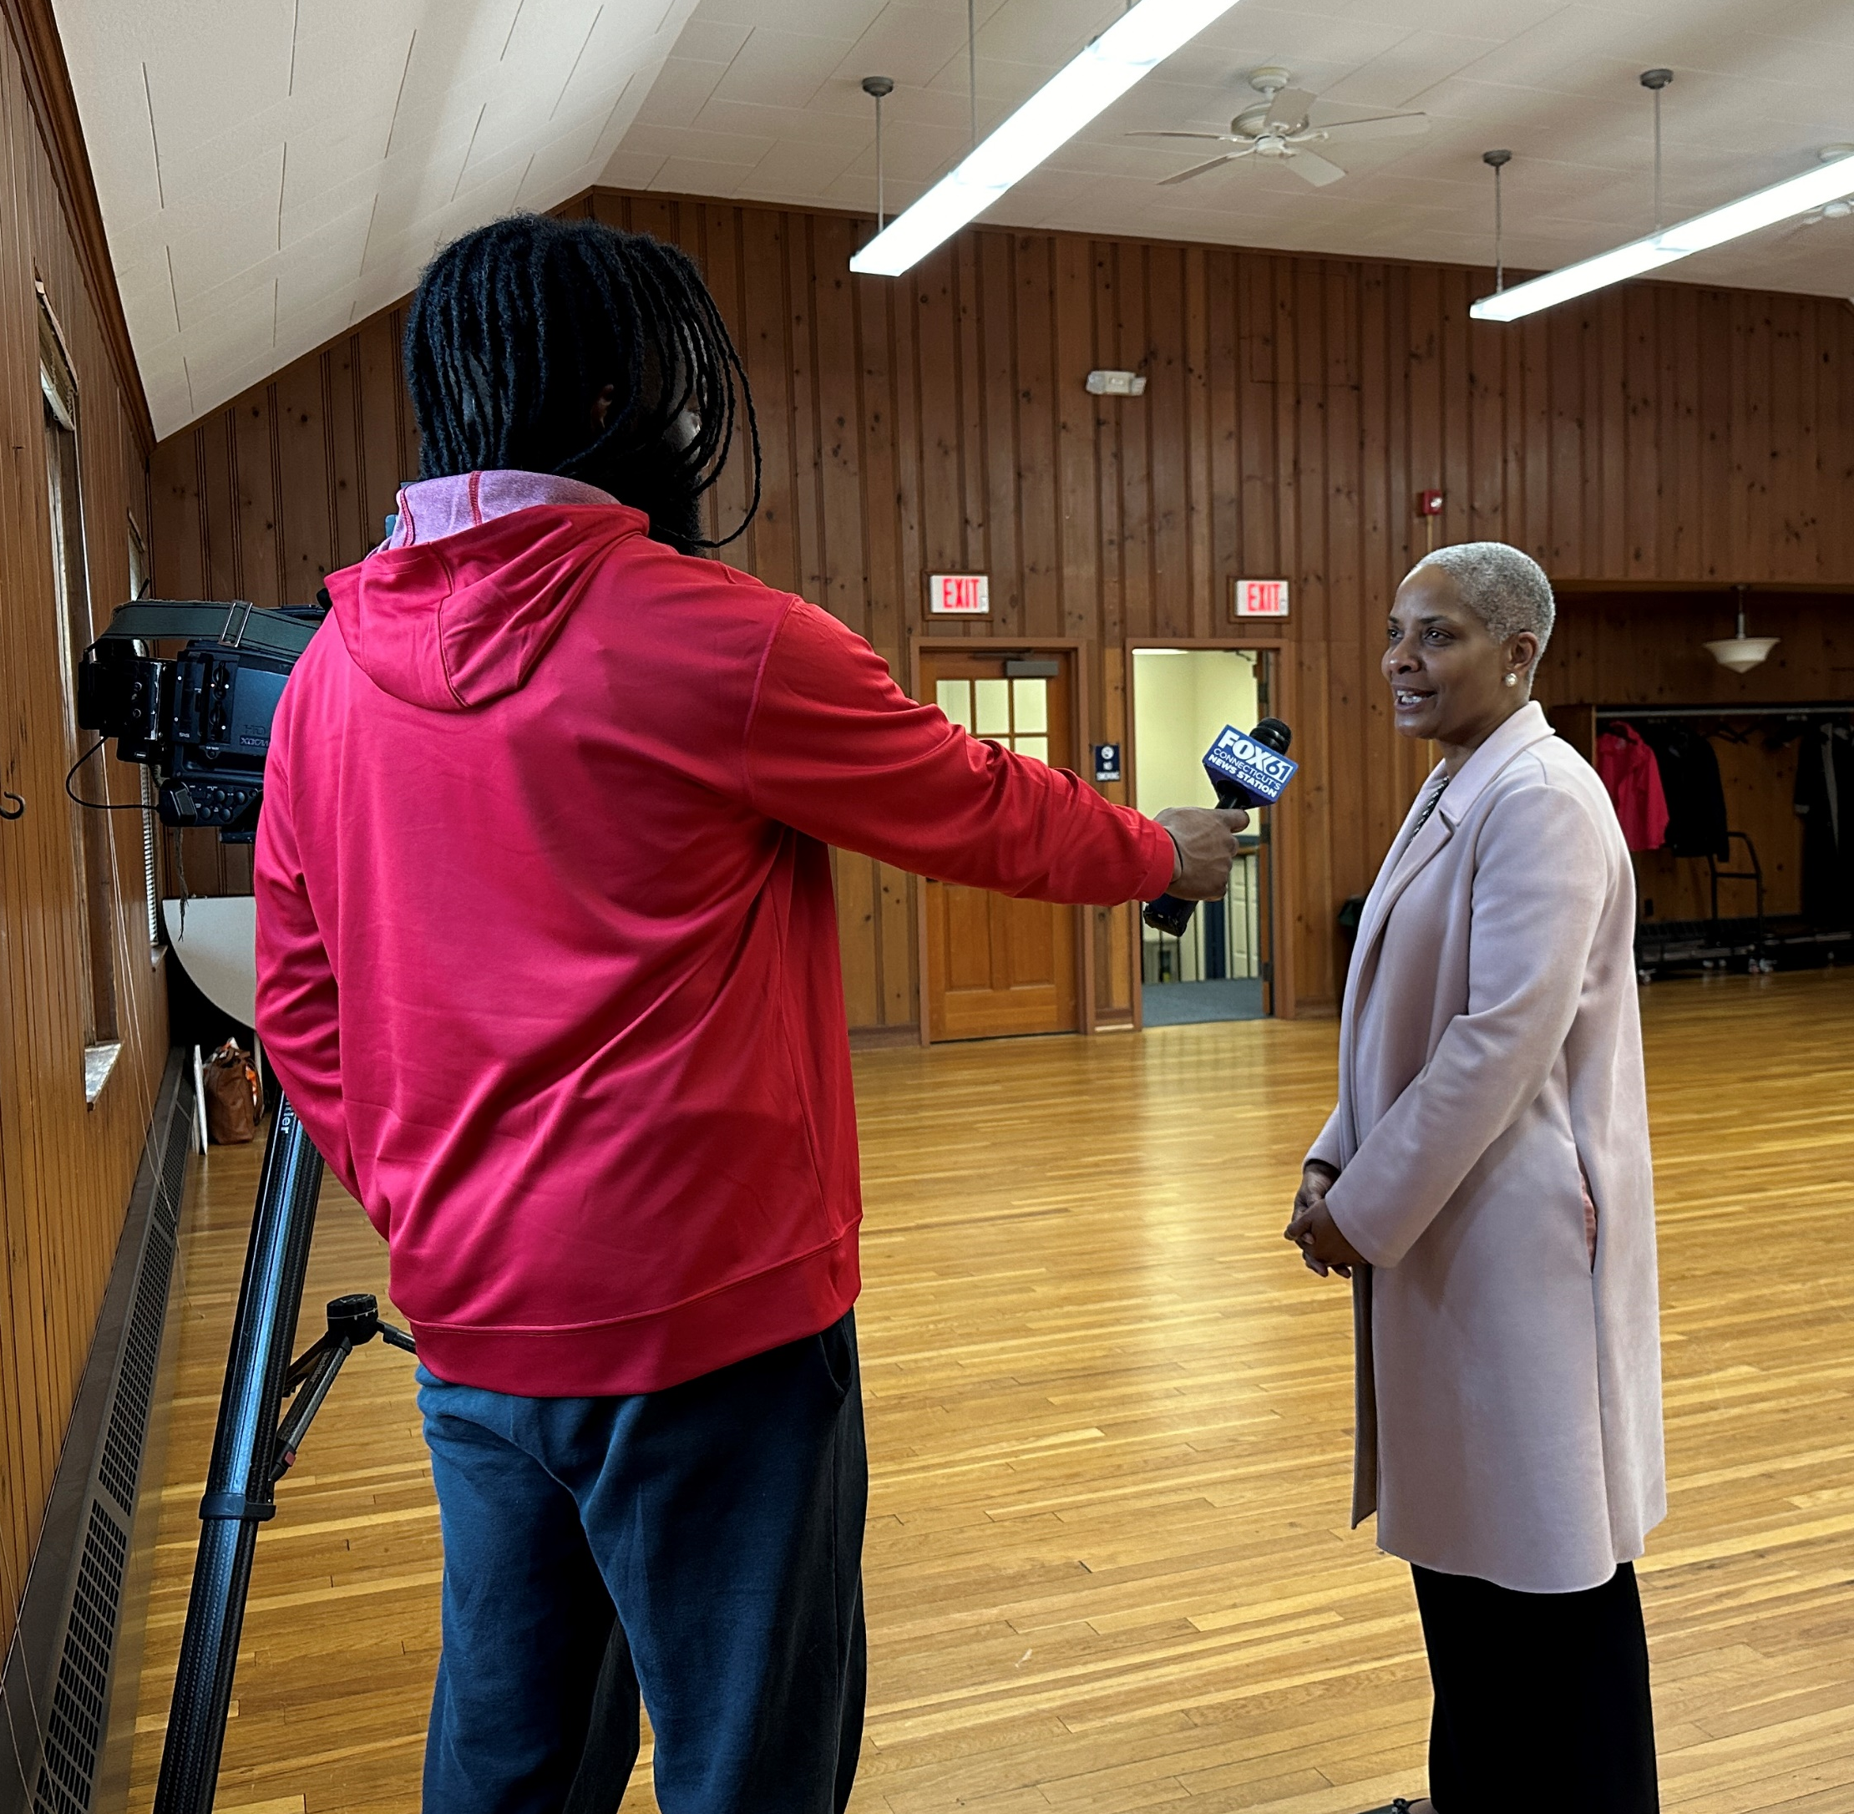
Updates
Media Training
VOICE CT
NASS IDEAS Award Finalist
Office of the Connecticut Secretary of the State

Slide 11
Voter Registration for Incarcerated Individuals
Title
Over 4,000 people are incarcerated annually who have not lost their right to vote
If you are interested in assisting with this program, please email Arienne.Orozco@ct.gov.
Towns with correctional facilities:
Bridgeport
Brooklyn
Cheshire
Enfield
Hartford
New Haven
Newtown
Niantic
Somers
Suffield
Uncasville

Slide 12
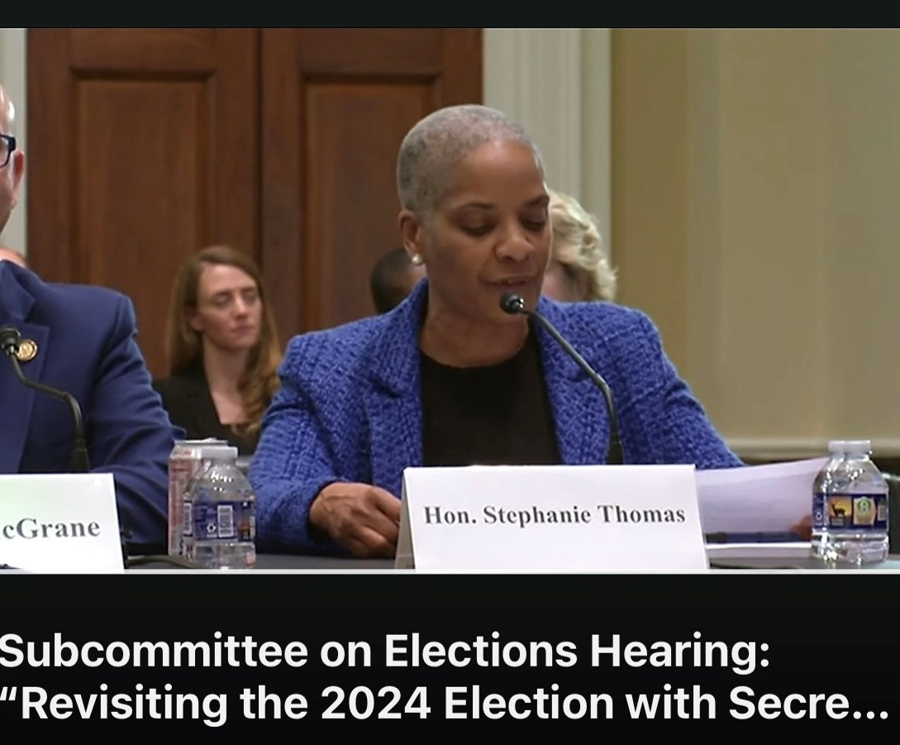
SAVE Act / Executive Order
Office of the Connecticut Secretary of the State

Slide 13
Bad for Connecticut
Title
Requires in-person voter registration
Registrars and Clerks would need to certify that the documents are valid
Mistakes could lead to fines or up to five years in jail
Private right of action allows individuals to report suspects to the DOJ
Usage of the Save database and Social Security databases – no batch lookups, costs up to $1.40 per lookup

Slide 14
Things You Can Do
Title
Write to the White House and Congress about federal items – the SAVE ACT and the Executive Order
Reach out to state delegation regarding early voting funding and other legislation
Sign up for a Poll Worker Appreciation event, voter registration for incarcerated, or for a Next Gen student
Let SOTS know if interested in Title 9 working group or media training

