Slide 1


New Registrar of Voters Class
Office of the Secretary of the State

Slide 2
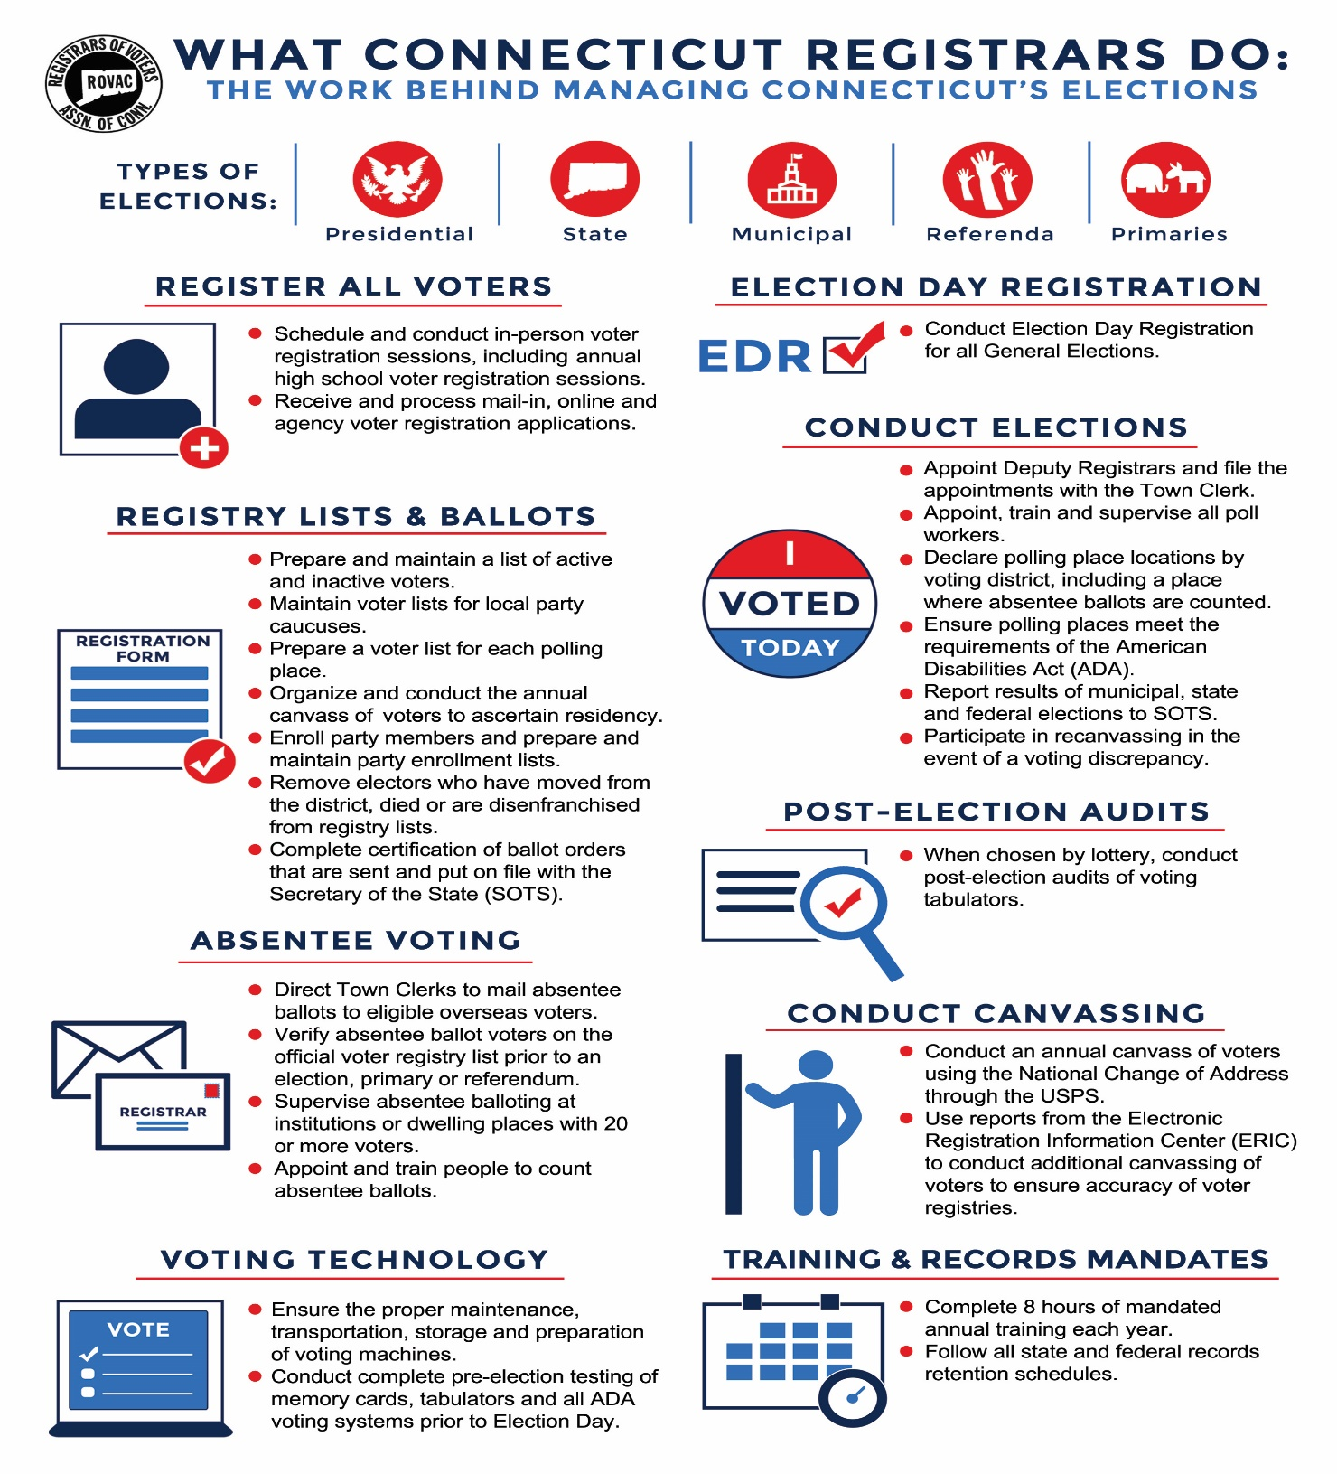

Slide 3

Secretary of the State Contact Information
Director of Elections: Kristin Sullivan - (860)509-6122 kristin.Sullivan@ct.gov
CVRS Issues: Taffy Womack – (860)509-6117 taffy.womack@ct.gov
Congressional District 1: Moriah Moriarty - (860)509-6116 moriah.moriarty@ct.gov
Congressional District 2: Mark Severance - (860)357-5369 mark.severance@ct.gov
Congressional District 3: Lori Magora - (860)438-6250 lori.magora@ct.gov
Congressional District 4: Tim De Carlo - (860)929-1061 timothy.decarlo@ct.gov
Congressional District 5: Heather Augeri - (860)356-0954 heather.augeri@ct.gov

Slide 4
Title
UCONN School of Public Policy
9-192 a requires that all Registrar of Voters shall complete a certification program before the completion of their second year in office.
The Registrar of Voters Certification Program is administered by the UConn School of Public Policy.
Information on the program can be obtained on their website, or by emailing rov@uconn.edu

Slide 5
Title
Key Dates April – September 2025
Party endorsements: July 15-22, 2025
Certification of endorsements: July 23, 2025 (4:00 p.m.)
Nominating petitions filed by: August 6, 2025 (4:00 p.m.)
Primary petitions filed by: August 6, 2025 (4:00 p.m.)
Primary September 9, 2025 (6:00 a.m. – 8:00 p.m.)

Slide 6
Title
Methods of Registering Voters & Letters Sent to Voters
Online Voter Registration
DMV / Tumbleweed
In person / mail-in registrations
High Schools
Permanent Absentee Letter
Acceptance / Change Letter
Disenfranchisement Letter
DMV Letter
ED 683 / CVR Letters
Rejection Letter

Slide 7
Title
Tumbleweed /DMV
Tumbleweed – is the DMV ‘s secure server which registrars of voters and tax collectors have access to records showing address changes made by residents of your town by the residents. (§9-19i).
DMV Registration –Voter Registration that takes place during a transaction at the DMV through the Motor Voter Act of 1993

Slide 10
Title
Deadlines
May 1st Last day to send Notice of Confirmation of Voting Residence (CVR) to electors based on the canvass. (Sec. 9-35)
June 9th Final day to change political enrollment and be eligible to vote in the September Primary (Backdate in CVRS if needed)
June 11th Last day for registrars, when necessary, to designate to the Clerk a polling place in an adjacent district for the September 2025 Primary.
July 15-22 Primary Petitions Available. Petition forms for persons desiring to oppose party-endorsed candidates for municipal office must be available from the registrar of voters beginning on the day following the making of the party's endorsement of candidates for municipal office or beginning on the day following the final day for the making of such endorsements, whichever comes first. (Secs. 9- 372(5) and 9-409)

Slide 11
Title
Deadlines
August 5th Last day for registrars, when necessary, to designate to the Clerk a polling place in an adjacent district for the November 2025 General. (9-453n)
August 6th Final day for candidates to submit Primary Petition Pages to your office. Your office MUST be open between 1:00 PM – 4:00 PM
to accept any petitions. (9-405 & 9-406)
August 8th Last day to determine polling places for municipal primary election. Polling places may be changed within a 31-day period only if the Clerk and ROVs unanimously find that the polling place has been rendered unusable, another polling place must be designated forthwith and adequate notice of such change published (9-168 & 9-169)

Slide 12
Title
Deadlines
August 7-17 Towns holding a primary with a population of 25,000 or more must publish a notice in a newspaper of a registration session that will be held in your office on August 22, 2025. (9-16)
August 19th Last day for ROVs to designate in writing to the Clerk whether ABs will be centrally counted. The location of central counting will need to be indicated in the notice. (9-147a)
August 19th Final day to certify with SOTS the number of ballots for each polling place for the September Primary (9-255a)
August 22nd Mandatory Primary Enrollment Session for towns of 25,000 or more. The office must be opened at least two consecutive hours between the hours of 12:00 noon and 9:00 PM (9-51)

Slide 13
Title
Deadlines
August 22nd Registration and Enrollment Cut off for the September Primary. In- person registration cut-off, mail-in must be postmarked by this date, online must be received by this date. (9-23g, 9-56 & 9-57)
August 29th The ROVs shall, before the 10th day of a primary election conduct pre-election testing of the voting tabulators. (9-238 & 9-247)
September 2nd First day AB’s can be checked off the Official List. (9-140c)
September 2nd Early Voting begins (Note: Adjusted for Labor Day, hours are now
8:00 am – 8:00 pm for this day)
September 7th Deadline for the list of Unofficial Checkers to be submitted by Campaigns to the ROV (9-436a)

Slide 14
Title
Deadlines
September 8th Final day of Supervised Balloting, all balloting of nursing homes should be completed no later than this date. (9-159q, 9-159r)
September 8th Deadline for registering in Person the day before the Primary. Cutoff to register in person is at Noon. Applications for servicemembers and persons out of the country under (9-23a, 9- 26) may be received throughout the day.
September 9th Primary Election, Polls open 6:00 am – 8:00 pm
September 10-13 Amendments to the Head Moderator return can take place during this period.
September 11th Lottery to Determine Order of November Ballot for Multiple- Opening Office

Slide 15
Title
Deadlines
September 12th Last Day for Discrepancy Recanvass (9-311)
September 16th Deadline for conducting a Close Vote or Discrepancy Recount
(9-310, 9-311a, 9-311b, 9-370a, 9-445 & 9-446)
September 9th Primary Election, Polls open 6:00 am – 8:00 pm
September 10-13 Amendments to the Head Moderator return can take place during this period.
September 24th Final day for towns chosen to complete a post-election audit. (9- 320f)

Slide 16
Title
CVRS
The Centralized Voter Registration System (CVRS) is the system that you will use to process and make changes to a voter’s profile.
CVRS is where you will find your daily online voter registrations as well as changes through the DMV / Tumble Weed systems.
Make sure when you process a new voter to write down the voter ID# on the card. While not mandatory, this will help you locate the voter should they be taken in error.
The CVRS System also generates several reports that you will need. These reports are also allowed to be given to the public upon request.
Change in Detail Report
Disk file (entire voter file in text format)
Alpha List
Street Guide

Slide 17
Title
CVRS / SSVR
Each town has an SSVR master account for CVRS.
This account allows you to create and delete users. You can also lock and unlock active accounts.
This account is to be shared with each Registrar in the office.

Slide 18
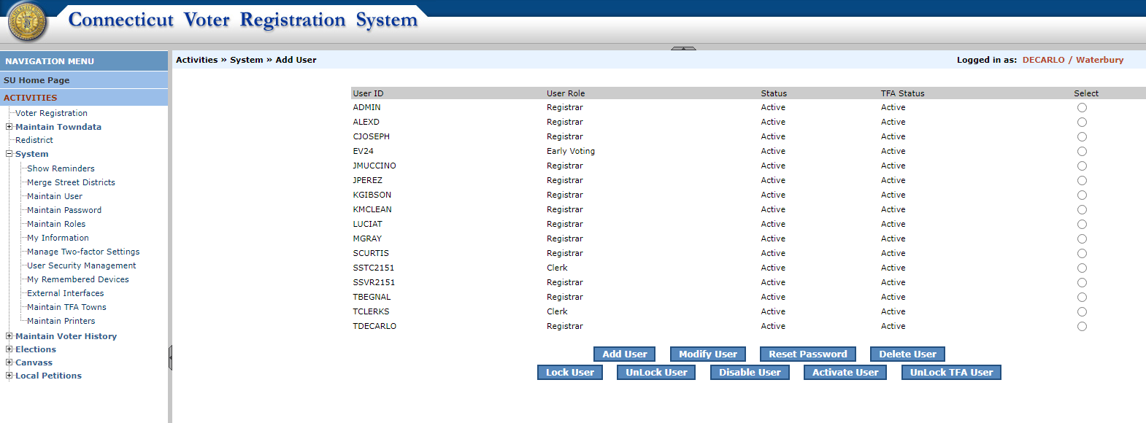
Title
CVRS / SSVR

Slide 19
Title
Sec. 9-174a. Emergency contingency plan
for elections
Sec. 9-174a. Emergency contingency plan for elections. Model plan. (a) For each municipality, the registrars of voters, in consultation with the municipal clerk, shall create an emergency contingency plan for elections, primaries and referenda to be held within such municipality.
Such plan shall include, but not be limited to, (1) solutions for ballot or envelope shortages, and (2) strategies to implement in the event of (A) a shortage or absence of election or primary officials at the polling place or the location designated for early voting, as applicable, (B) a loss of power, (C) a fire or the sounding of an alarm within a polling place or a location designated for early voting, (D) voting machine malfunctions, (E) a weather or other natural disaster, (F) the need to remove an election or primary official and to replace such official, and (G) disorder in and around the polling place or the location designated for early voting.

Slide 20
Title
Avoid a disaster before it occurs
Early Permission and Site Check
Check with those in charge of your polling place well in advance of the election to make sure that the location will be operational on the day of the election. Make sure to conduct a site visit before the election to make sure everything will be operational for the Primary.
Pre-Election Organization Meeting
Before every election, you should consider calling a meeting in which everyone who would have some kind of role is present. For example, are your polling places owned by the municipality or are they rentals? Who will be delivering your election equipment and who will be accepting delivery? Are the local authorities prepared to assist you should you lose power or have an emergency at the polls? Is everyone aware of what your Emergency Plan entails and are they ready to assist your office should a problem develop?
Keep in mind School will be in session on September 9th, 2025

Slide 21

Title
Primary Petitions:
Given by Registrars / SOTS
Shorter window to obtain signatures
Signatures needed = Depending on the office, 2% or 5% of total party enrollment in the state, district, or municipality
Success = Primary election
Two Ways to Access the Ballot
Primary Petitions
Vs
Nomination Petitions
text
Nomination Petitions
Given by Town Clerks / SOTS
Longer window to obtain signatures
Signatures needed = The lesser of 7,500 or 1% of the total number of votes cast in the last election
Success = Access to the November ballot

Slide 22

Primary Petitions Basics
Only major parties can hold primary elections in Connecticut, therefore only candidates in the Democratic and Republican parties can be issued Primary Petitions.
Primary Petition Pages are obtained by candidates looking to force a Primary Election against the endorsed candidate(s).
The person requesting a petition form must give the following information to the Registrar of Voters before it can be issued:
  their own name and address;
  the name, address, and office sought of each candidate for whom the petition is being obtained; and
  a statement signed by each such candidate that they consent to be a candidate for the listed office.
5% of the total party enrollment in the municipality for municipal office (e.g., Mayor).
When issuing primary petition forms, the forms must be double-sided and on legal size paper.

Slide 23
Who Can Circulate
Each circulator must be an enrolled member of the party holding the primary, in any town in this state.
No candidate, whether an endorsed or petitioning candidate, may circulate a petition for another candidate (or another group of candidates contained in one petition) for the nomination of the party for the same office.
No person may circulate petitions for more than the maximum number of candidates to be nominated by a party for the same office. A candidate may circulate a primary petition in which they are proposed as a candidate. Registrars must reject any petition page circulated in violation of these provisions of the law

Slide 24
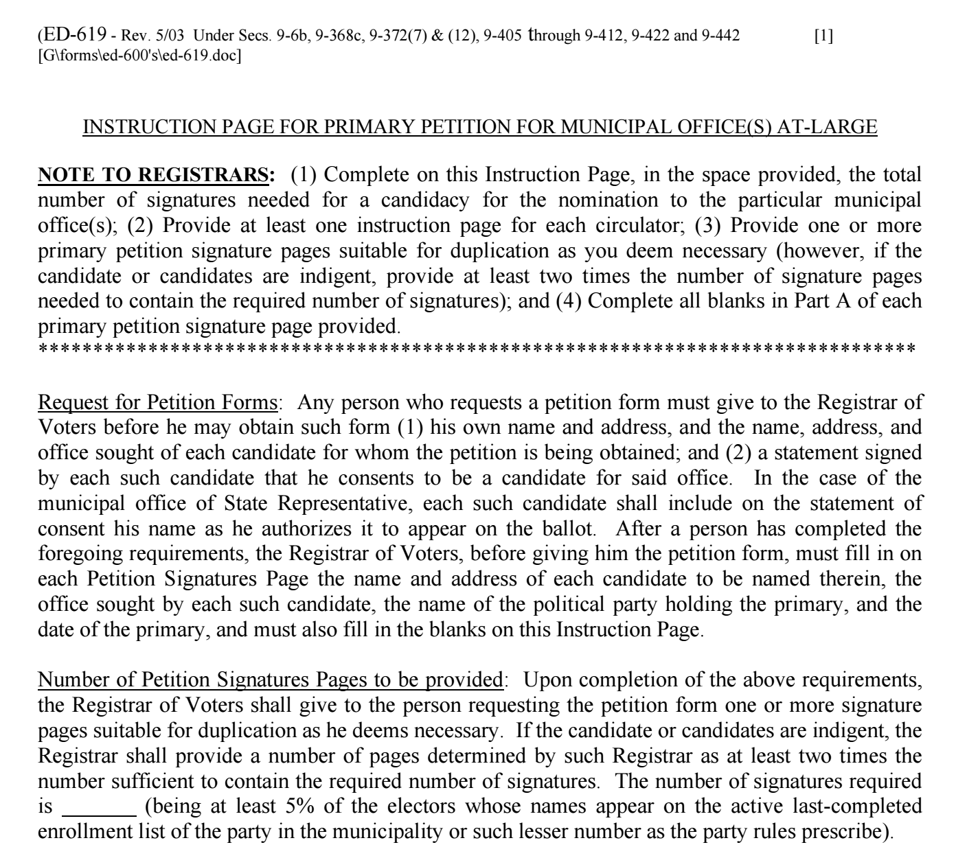
Back Side of Instruction Form
The registrar must insert the number of signatures needed before giving the forms to the candidate.

Slide 25
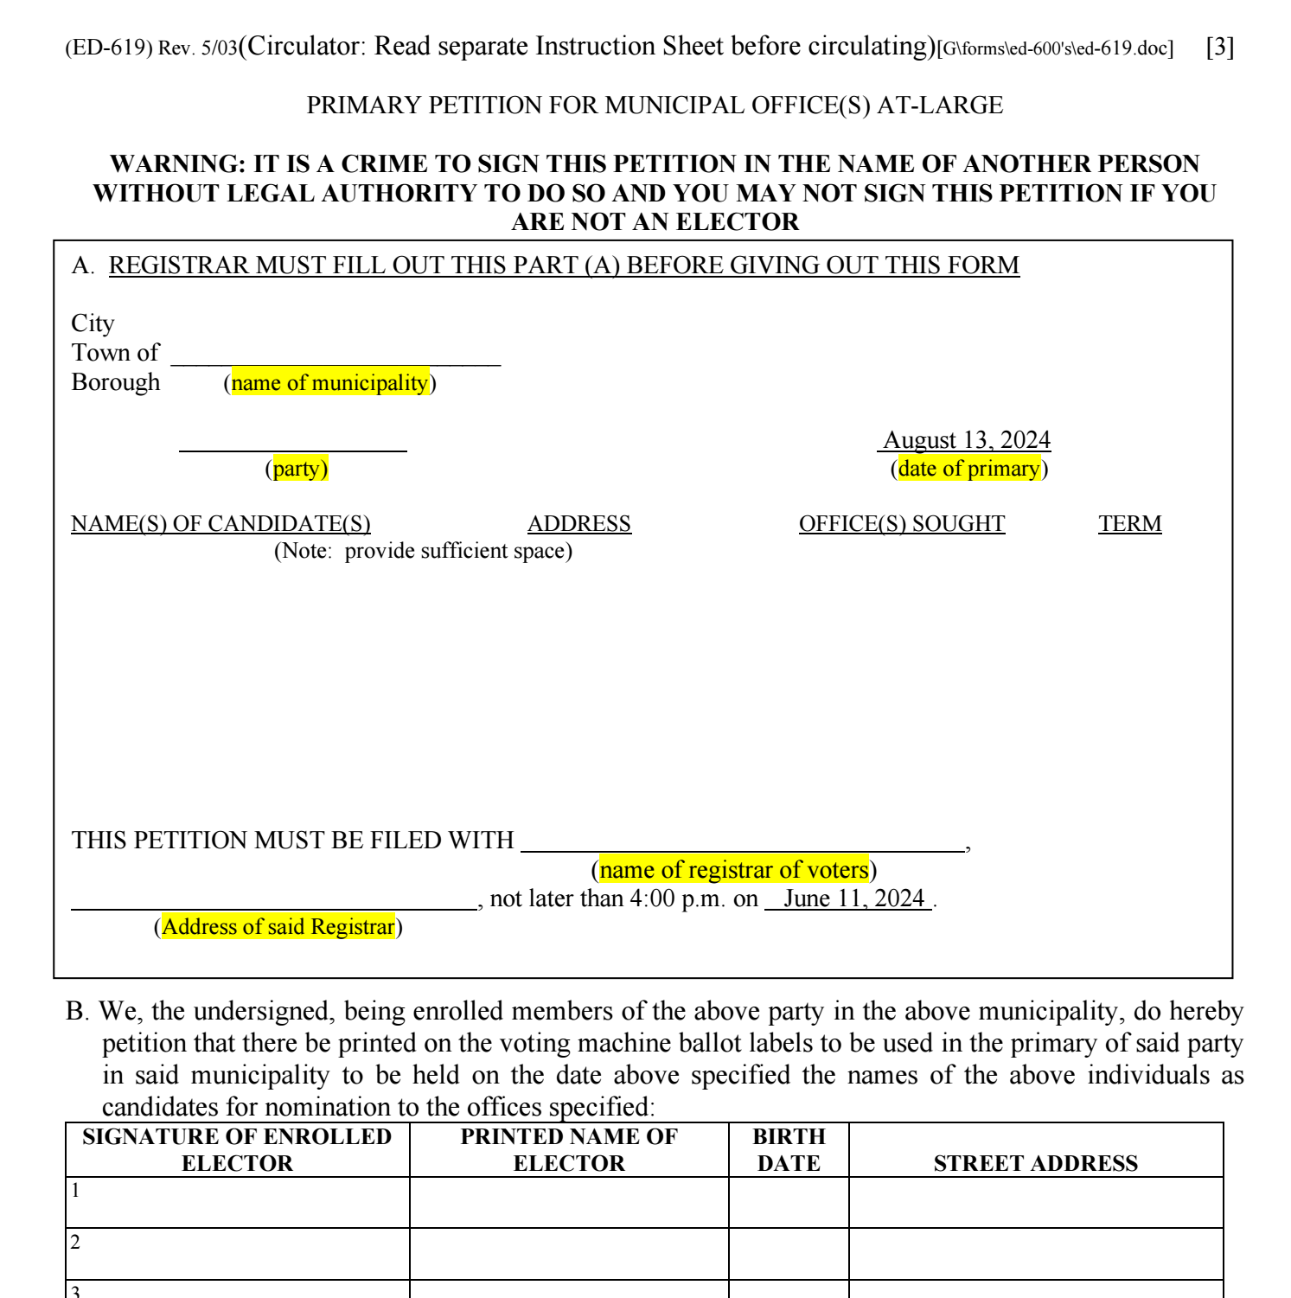
Front Side of Petition Form
These sections are completed by the Registrar

Slide 26
Processing
Registrars are to accept the signature of an elector who:
Appears at said address and has active status
Appears at said address and has inactive status (restore voter in CVRS)
Registrars are to reject the signature of an elector who:
Is not enrolled in the political party attempting to have a primary
Is not a registered voter in their town
Has “Off status” in CVRS
Registrars are to reject the entire form if:
Sections C or D of the petition are not completed
The petition is submitted single-sided or stapled together.

Slide 27
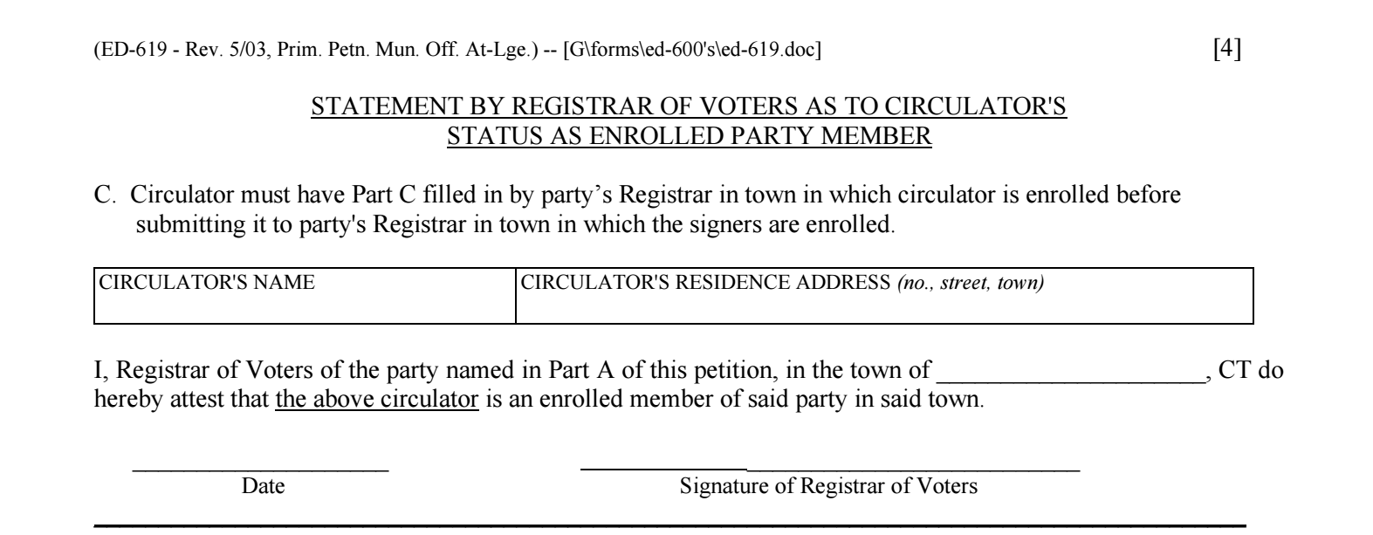
Back Side of Petition Page
This section must be completed by the Registrar of the town in which the circulator is registered to vote.
If this is not completed upon submission to the Registrar of Voters Office, the registrar must reject.

Slide 28
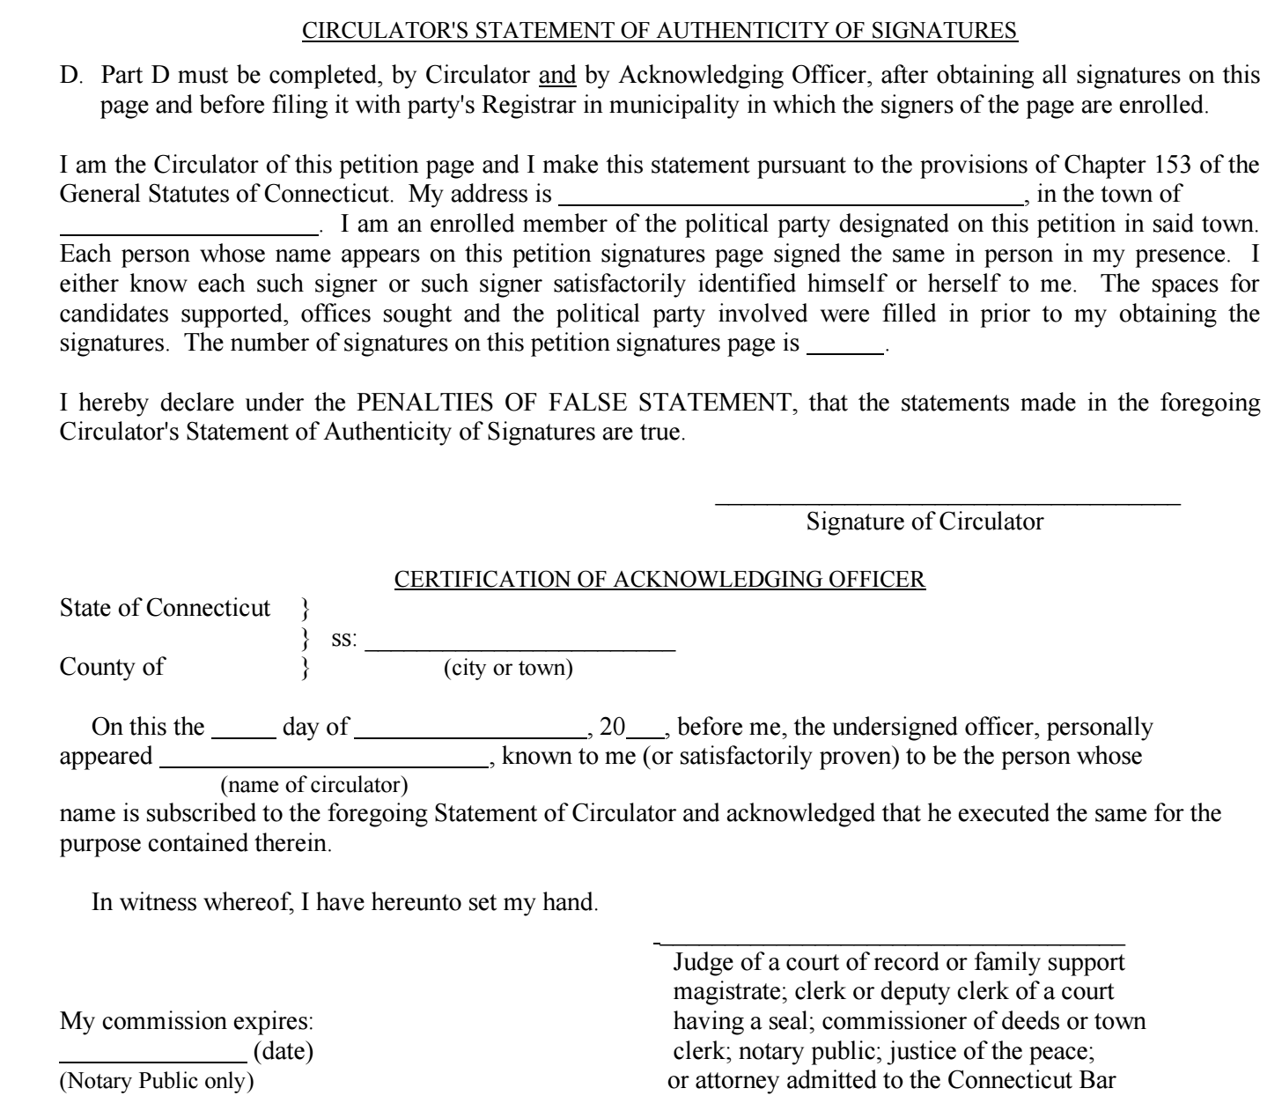
Back Side of Petition Page
These sections must be completed by the Registrar in which the circulator is registered to vote.
If this is not completed upon submitted to the Registrar of Voters Office, you must reject.

Slide 29
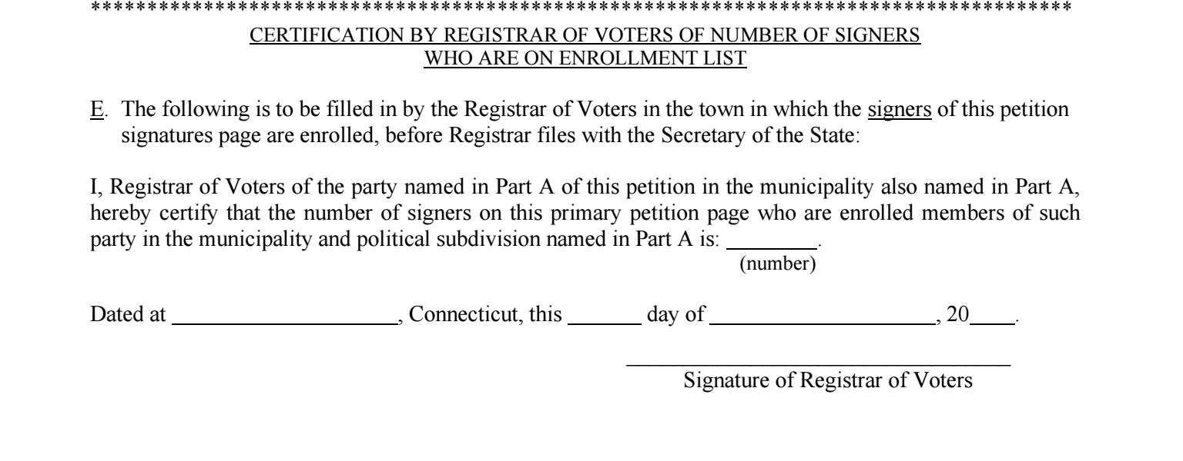
Back Side of Petition Page
This section must be completed by the Registrar after processing the petition.
Failure to complete this section will cause the form to be rejected.

Slide 30
Title
EMS Setup
Town Clerks & SOTS
Primary Created in EMS by SOTS
Offices assigned to Primary by SOTS
Candidates added to Primary by SOTS
Certification of Ballot Ordered this can be done by both Town Clerk or ROV’S for primaries.

Slide 31
Title
EMS Setup
ROVS
Assigned Polling Places to Primary
  Add or change polling locations if necessary. Make sure to notify SOTS.
Assign a Head Moderator to the Primary
  You may assign moderators, data entry, etc., and provide a password
  Have a paper backup ready in case of a system failure. The form should be provided by SOTS.
  Do not assign your EV and SDR locations as polling places

Slide 32
Title
Pre-Primary Election Reminders
      Make sure when you run your Official List for the polls to select only the party holding the primary, as well putting in the date of the primary. If the primary date is not put in, voters without Party Privilege will appear on your list.
      Remember that 17-year-old voters who will be 18 on or before Election Day are allowed to vote, however they will appear at the back of your list stating that they are not yet 18. Make sure your Moderator and checker are aware of this issue.
      There is no Election Day Registration for Primary Elections
      You will only need one set of poll workers unless both Major Parties are holding primaries that day. You may take poll workers suggested by candidates, but you are not required to do so.
      You may use less privacy booths than in a General Election. One privacy booth per every 500 registered voters.
      Make sure to use the Municipal ID Poster for the Checker’s table.

Slide 33
Title
Poll Worker Training
It is the responsibility of the ROV to make sure that all poll workers receive adequate training before every election.
Moderators' certification must be up to date. If their certification has lapsed, make sure they attend a certification class prior to Election Day. The list of certification dates can be found on ROVAC.org
Make sure that your poll workers are aware of your Emergency Plan should an issue arise at the polls, i.e., ballot shortage, poll workers who fail to arrive, loss of power, fire, etc.

Slide 34
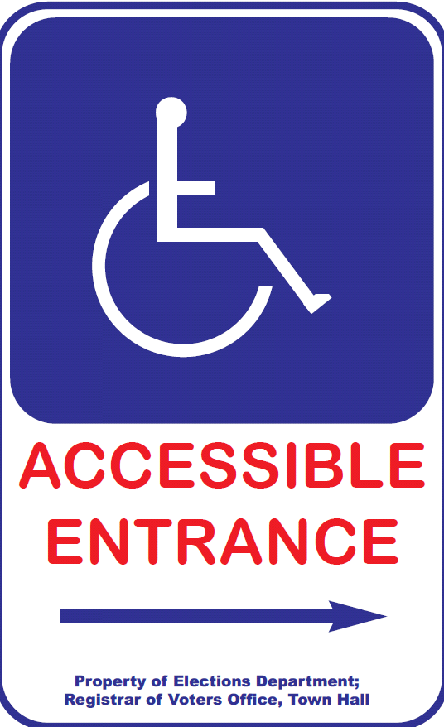
Title
Polling Place Must Be “Accessible”
Moderator should :
  Check parking lot signs
  Post signs to accessible entry, if applicable
  Clear all accessible pathways in polls
  Set up wheelchair-accessible privacy booth
  Understand curbside voting process
  Confirm presence/set-up of IVS

Slide 35
Title
Department of Justice ADA Checklist
https://www.ada.gov/votingchecklist.pdf

Slide 36
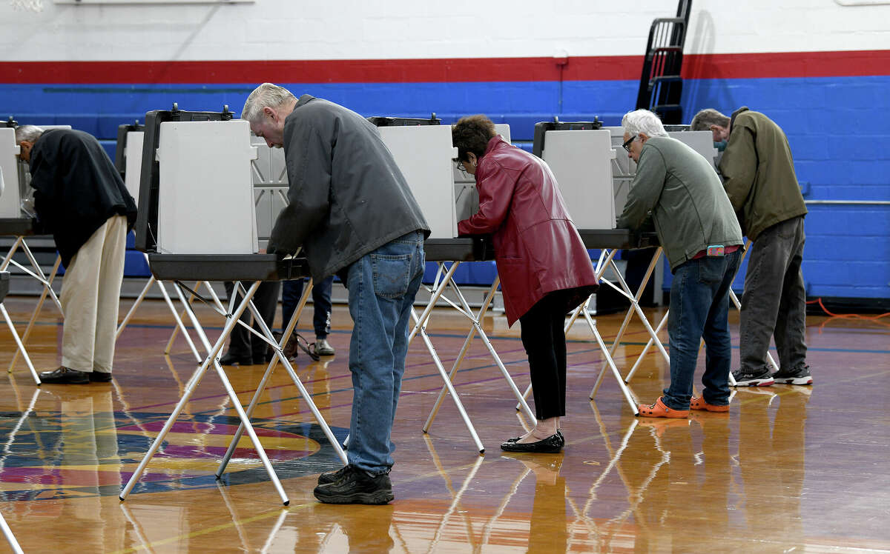
Title
Persons Allowed Inside Polling Place
Electors (while voting)
Person assisting elector in voting or with curbside voting
  NO candidate unless member of voter’s immediate family.
  NO representative of employer or union. Record each name.
Children of the elector (must be supervised, 15 or younger)
Secretary of the State’s Designees
News media (identify themselves to moderator, no photos of any votes )
Registrar of Voters
Unofficial Checkers
PTA Bake Sales

Slide 37
Title
Polling Place Signage
To be posted during elections
3 Easy Steps to Voting
ID Requirements for Voters with Asterisks “*” (per HAVA)
Voters Bill of Rights
Instructions for Provisional Ballots (Federal Only)
Voter ID for checker’s table.

Slide 38
Title
Voter ID Requirements For Checkers Table

Slide 39
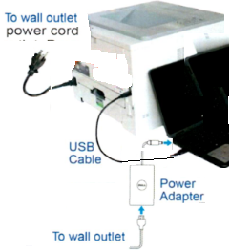
Title
Ballot Marking System Set-up
Printer & computer plugged into power outlet.
USB cable plugged in from computer to printer.
Keypad and headphone plugged into computer.
Ensure paper tray is open, extended & tray sleeve installed.
Load 1 plain piece of paper onto paper tray
Turn “On” Printer and Computer
Press “Print” on computer screen.
  A startup report will print.
Press “No” on computer screen
Access Code 9630

Slide 40
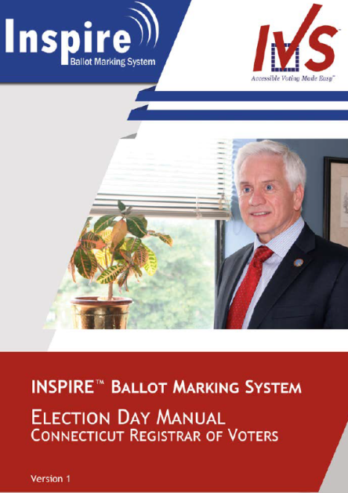
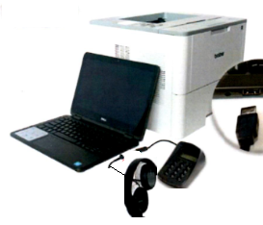

Slide 41
Title
Early Voting
Requirement | General Election | Primary Election | Pres. Preference Primary | Special Election
Start of Early Voting Period | 15 days before | 8 days before | 5 days before | 5 days before
End of Early Voting Period | 2 days before | 2 days before | 2 days before | 2 days before
Duration | 14 days | 7 days | 4 days | 4 days
Early Voting does not apply to Town Committee Primaries or Referenda Elections.

Slide 42
Title
Early Voting Hours
 | General Election | Primary Election | Pres. Preference Primary | Special Election
Weekday Hours | 10:00 AM – 6:00 PM except for the last Tuesday and Thursday before the election when the hours are 8:00 AM – 8:00 PM | 10:00 AM – 6:00 PM except for the last Tuesday and Thursday before the election when the hours are 8:00 AM – 8:00 PM | 10:00 AM – 6:00 PM | 10:00 AM – 6:00 PM
Saturday Hours | 10:00 – 6:00 | 10:00 – 6:00 | 10:00 – 6:00 | 10:00 – 6:00
Sunday Hours | 10:00 – 6:00 | 10:00 – 6:00 | 10:00 – 6:00 | 10:00 – 6:00

Slide 43
Title
Early Voting Locations
The act requires registrars of voters to designate a location in town—with access to the centralized voter registration system (CVRS)—in which to conduct both (1) early voting and (2) SDR during the early voting period preceding a regular general election. Municipalities with a population of 20,000 or more have the option of designating additional locations.
Separately, the law requires registrars of voters to designate a location for conducting SDR on Election Day (see below: “SDR Process for General Elections”). This location may be the same as or different than the location that is used to conduct SDR during the early voting period.

Slide 44
Title
Early Voting Process
Early Voting Process: To cast an early voting ballot, an elector must do the following:
Appear in person at an early voting location within the designated times;
Comply with election day identification requirements by either (a) showing adequate identification or (b) signing an affidavit attesting to his or her identity, and;
Declare under oath that he or she has not previously voted in the election by signing the affirmation on the back of the early voting envelope.

Slide 45
Title
Registration and Enrollment
Existing law allows a person to vote in a primary if he or she registers to vote and enrolls in person by noon on the day before the primary. The Early Voting Act similarly sets deadlines by which a person may register to vote or enroll in a party and vote during the early voting period before a primary.
Unaffiliated Voters
Under the early voting law, unaffiliated voters who seek to vote during early voting before a primary may do so if their enrollment application is filed in person with the registrars of voters by noon on the business day preceding the start of the early voting period. For example, if the early 13 voting period starts on a Tuesday, the enrollment application must be filed by noon on Monday (or if that day is a state holiday, on Friday). The person may then return starting Tuesday to vote early.

Slide 46
Title
Registration and Enrollment
New Registrants
Similarly, individuals who are not registered but file their voter registration application in person with the registrars or town clerk by noon the business day immediately before the day they want to vote early may (1) register and enroll in a political party and (2) vote during the early voting period starting the next voting day.
For example, if a person registers to vote by noon on Wednesday during an early voting period, they may return starting Thursday and vote early.

Slide 47
Title
Cast an EV Ballot
If the registrars of voters determine that the elector is eligible to vote, they must check CVRS to see if the elector has already voted.
If not, the elector must be given an early voting ballot and envelope, and the registrar must record the issuance.
An elector who receives an early voting ballot must privately mark it in the presence of the registrars or their designees. The elector must place the ballot in the early voting envelope, sign the affirmation on the back of the envelope, and deposit the envelope in a secured early voting ballot depository receptacle.

Slide 48
Title
Chain of Custody
At the conclusion of each day during the early voting period, registrars of voters must transport the receptacles containing the day’s early voting ballots, and SDR ballots in the case of a general election, to the municipal clerk who must secure and store them in a manner as similar as possible to the security and storage of absentee ballots.
The election officials who are present when the registrars transport the ballots to the town clerk must sign the Affidavit of Delivery and Receipt of Early Voting Ballots: Towns Where Town Clerks Store Ballots.

Slide 49
Title
Chain of Custody
If this type of storage is not practical, the registrars must prepare an alternate plan and submit it to the Secretary of the State for approval. The plan should indicate the basis for the request and set out clear chain of custody and storage procedures.
At a minimum, the registrars must store the ballots under lock and key in a tamper-proof, fire-proof receptacle. The receptacle must be locked in a secure room that is not generally accessible. When delivering ballots for counting on the day of the primary or election, these towns will use the Affidavit of Delivery and Receipt of Early Voting Ballots: Towns Operating Under an Alternative Storage Plan
The registrars of voters or town clerk, whichever applies, should limit access to the storage location and maintain a log of all people who have access to that storage location. For anyone who accesses the storage location, the log should show the names, dates, times, and purpose.

Slide 50
Title
Same Day Registration
Same Day Registration, (SDR) does not take place during Primary Elections in Connecticut.
SDR only takes place during the Early Voting Period of a General Election as well as the day of a General Election

Slide 51
Title
Post Election Audit
The Secretary of the States Office will conduct a lottery after the election. Those polling places selected will need to have a post election audit conducted.
The audit may be conducted either by manual or automated form. All automated audits take place in the Office of the Secretary of the State.
Regardless of the type of audit you perform it must still be noticed locally.
To conduct the audit manually make sure to reference the audit manual which is located on the SOTS website.
Polling places were a recanvass occurs are excused from being audited.

Slide 52
Title
Recanvass
A recanvas of an election can take place if the moderator (or head moderator in towns divided into voting districts) calls for a recanvas of the machine counted ballots, and/or the hand counted ballots, and/or absentee ballots and/or write-in ballots if he determines there is a discrepancy in the returns of any voting district in an election or primary. (§ 9-311)
Or
After any election or primary, when the plurality of the winning candidate for an office is 1 ½ of 1 percent or less than twenty votes are separating both the winning and defeated candidate for office.

