Slide 1
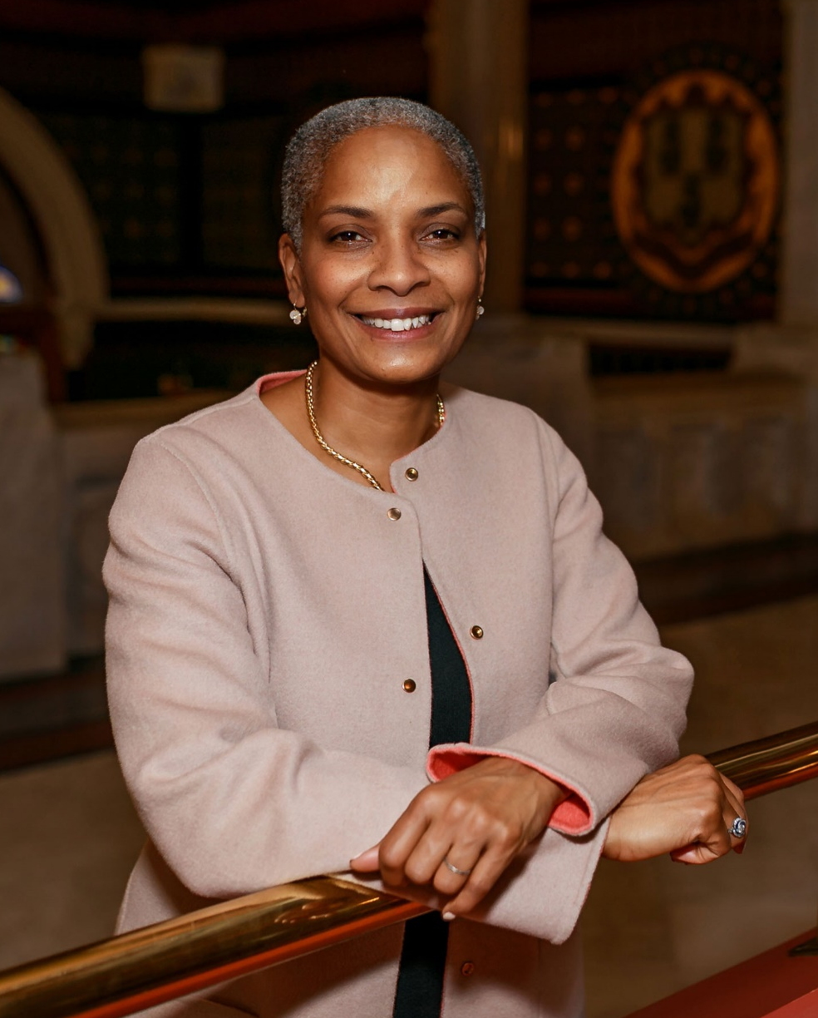
2024 ROVAC
Spring Conference
Secretary of the State Stephanie Thomas

Slide 2
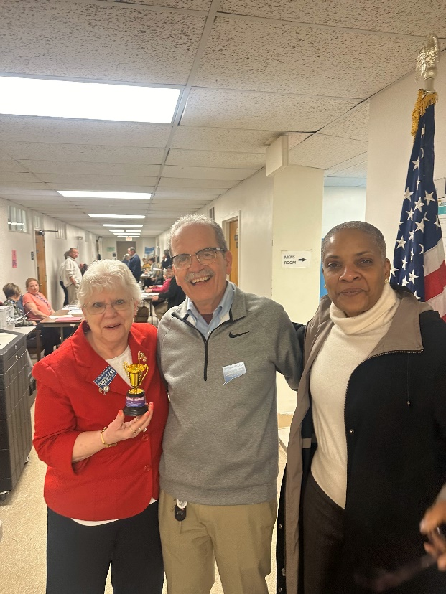
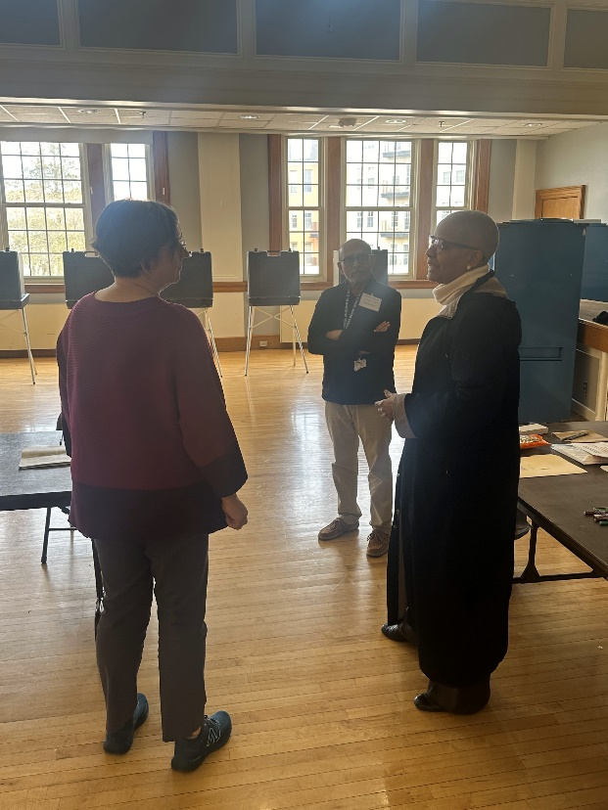
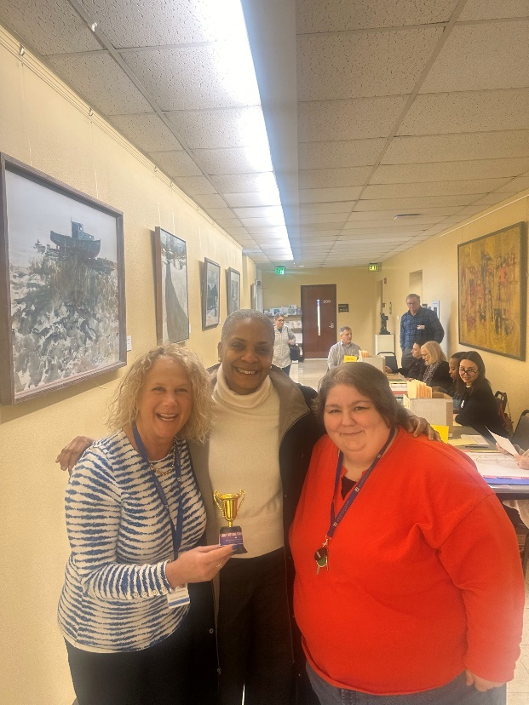
Debut of Early Voting –
We (YOU) Did It!
Title

Slide 3
Title
Top Early Voting Towns
Highest Number of Early Voters – Hamden (1,085), Wallingford (498), Westport (460), West Hartford (405)
Highest Early Voting Turnout – Chester (9.09%), Cornwall (7.46%), Lyme (6.79%), Salisbury (6.73%)

Slide 4
Title
Updates
Applying learnings and looking towards August
Legislative Priority
Title 9 Review
Tabulators

Slide 5
Title
Security
CTIC is looking out for you
If you see something, say something- it may help another town
Security Awareness Training (SANS program)
Emergency plans

Slide 6
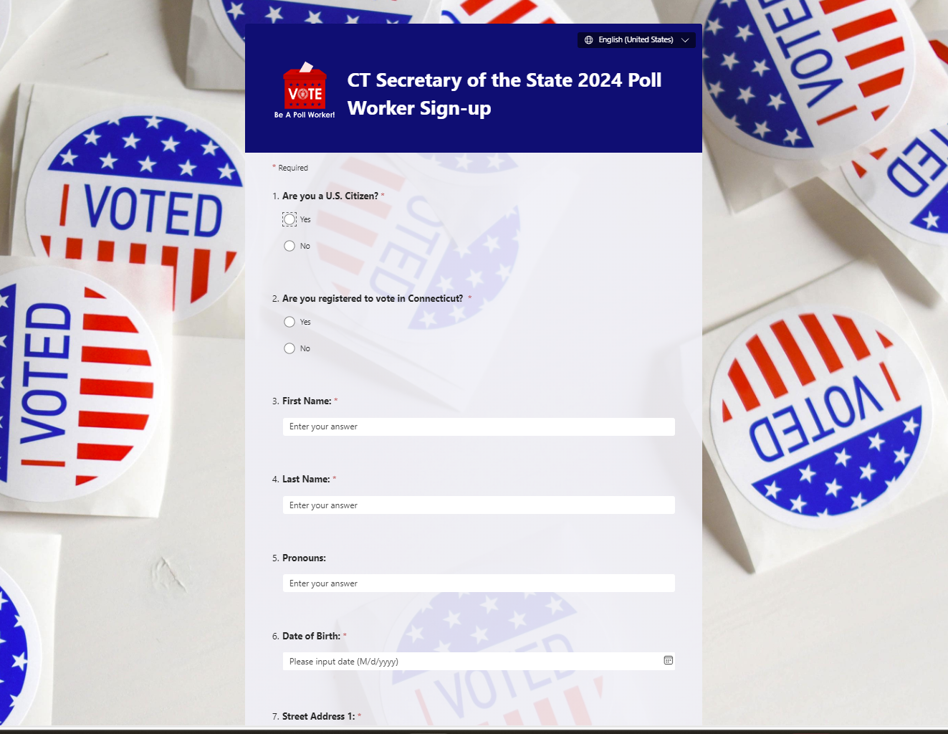
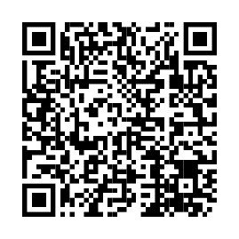
Title
Poll Worker Recruitment
SOTS will provide assistance.
List sent out monthly.
Recruit and vet early.
To view the form, scan this code →

Slide 7
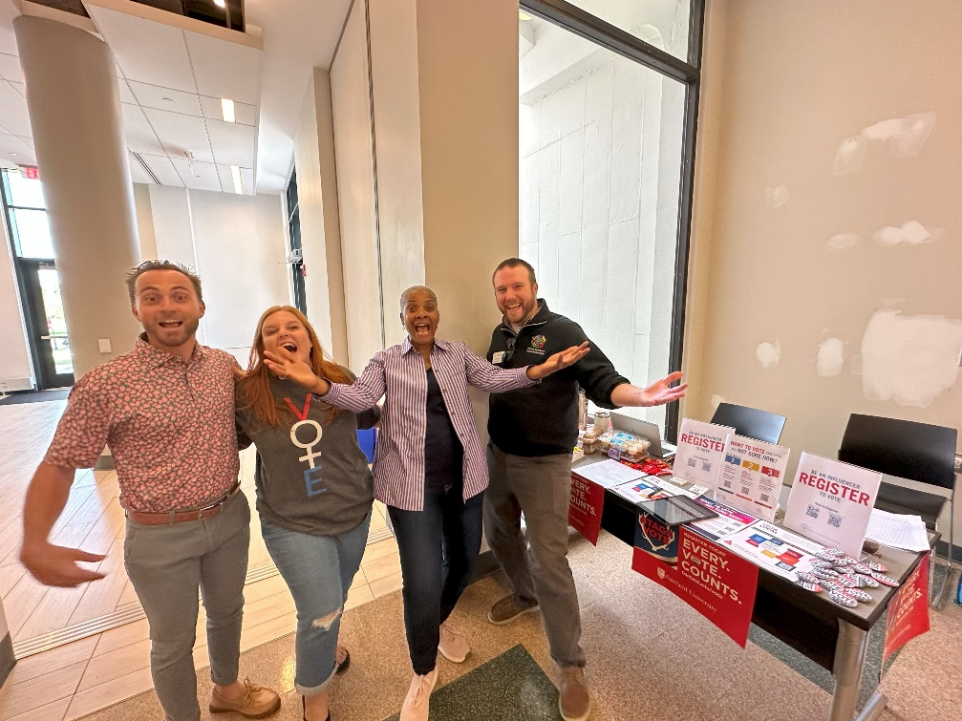
Title
Poll Worker Recruitment
For more information, visit the Civic Engagement tab on our website or email Civics101@ct.gov

Slide 8
Thank You for All that You Do!

