Slide 1
2023 ROVAC Fall Conference
Secretary of the State Stephanie Thomas

Slide 2
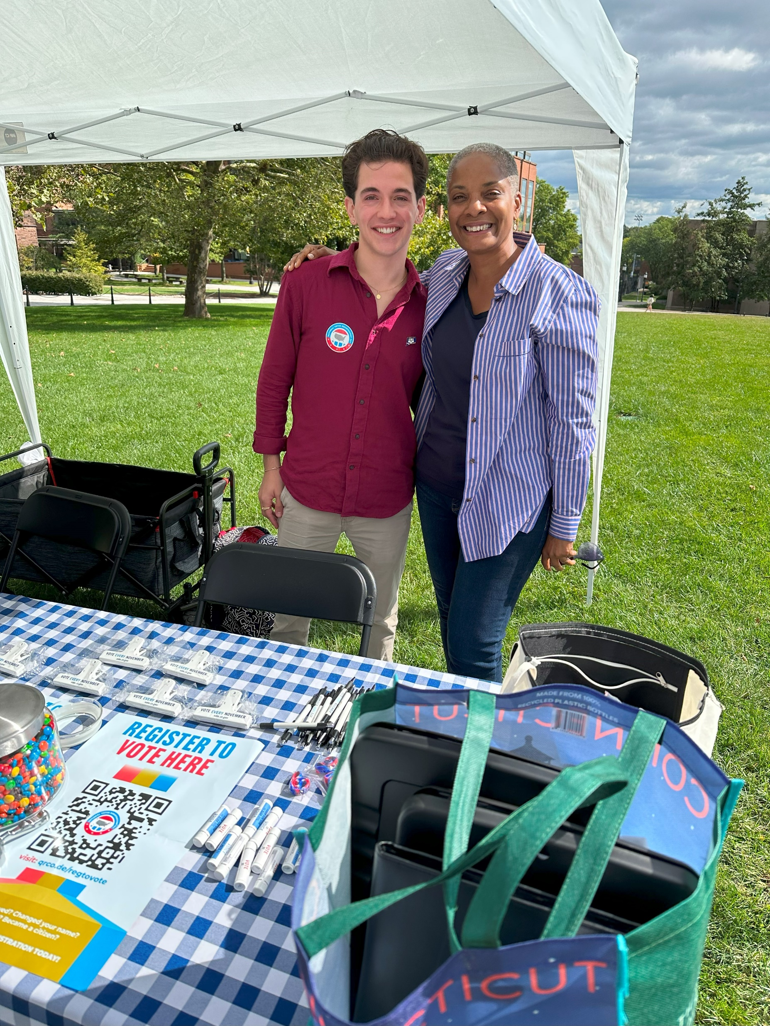
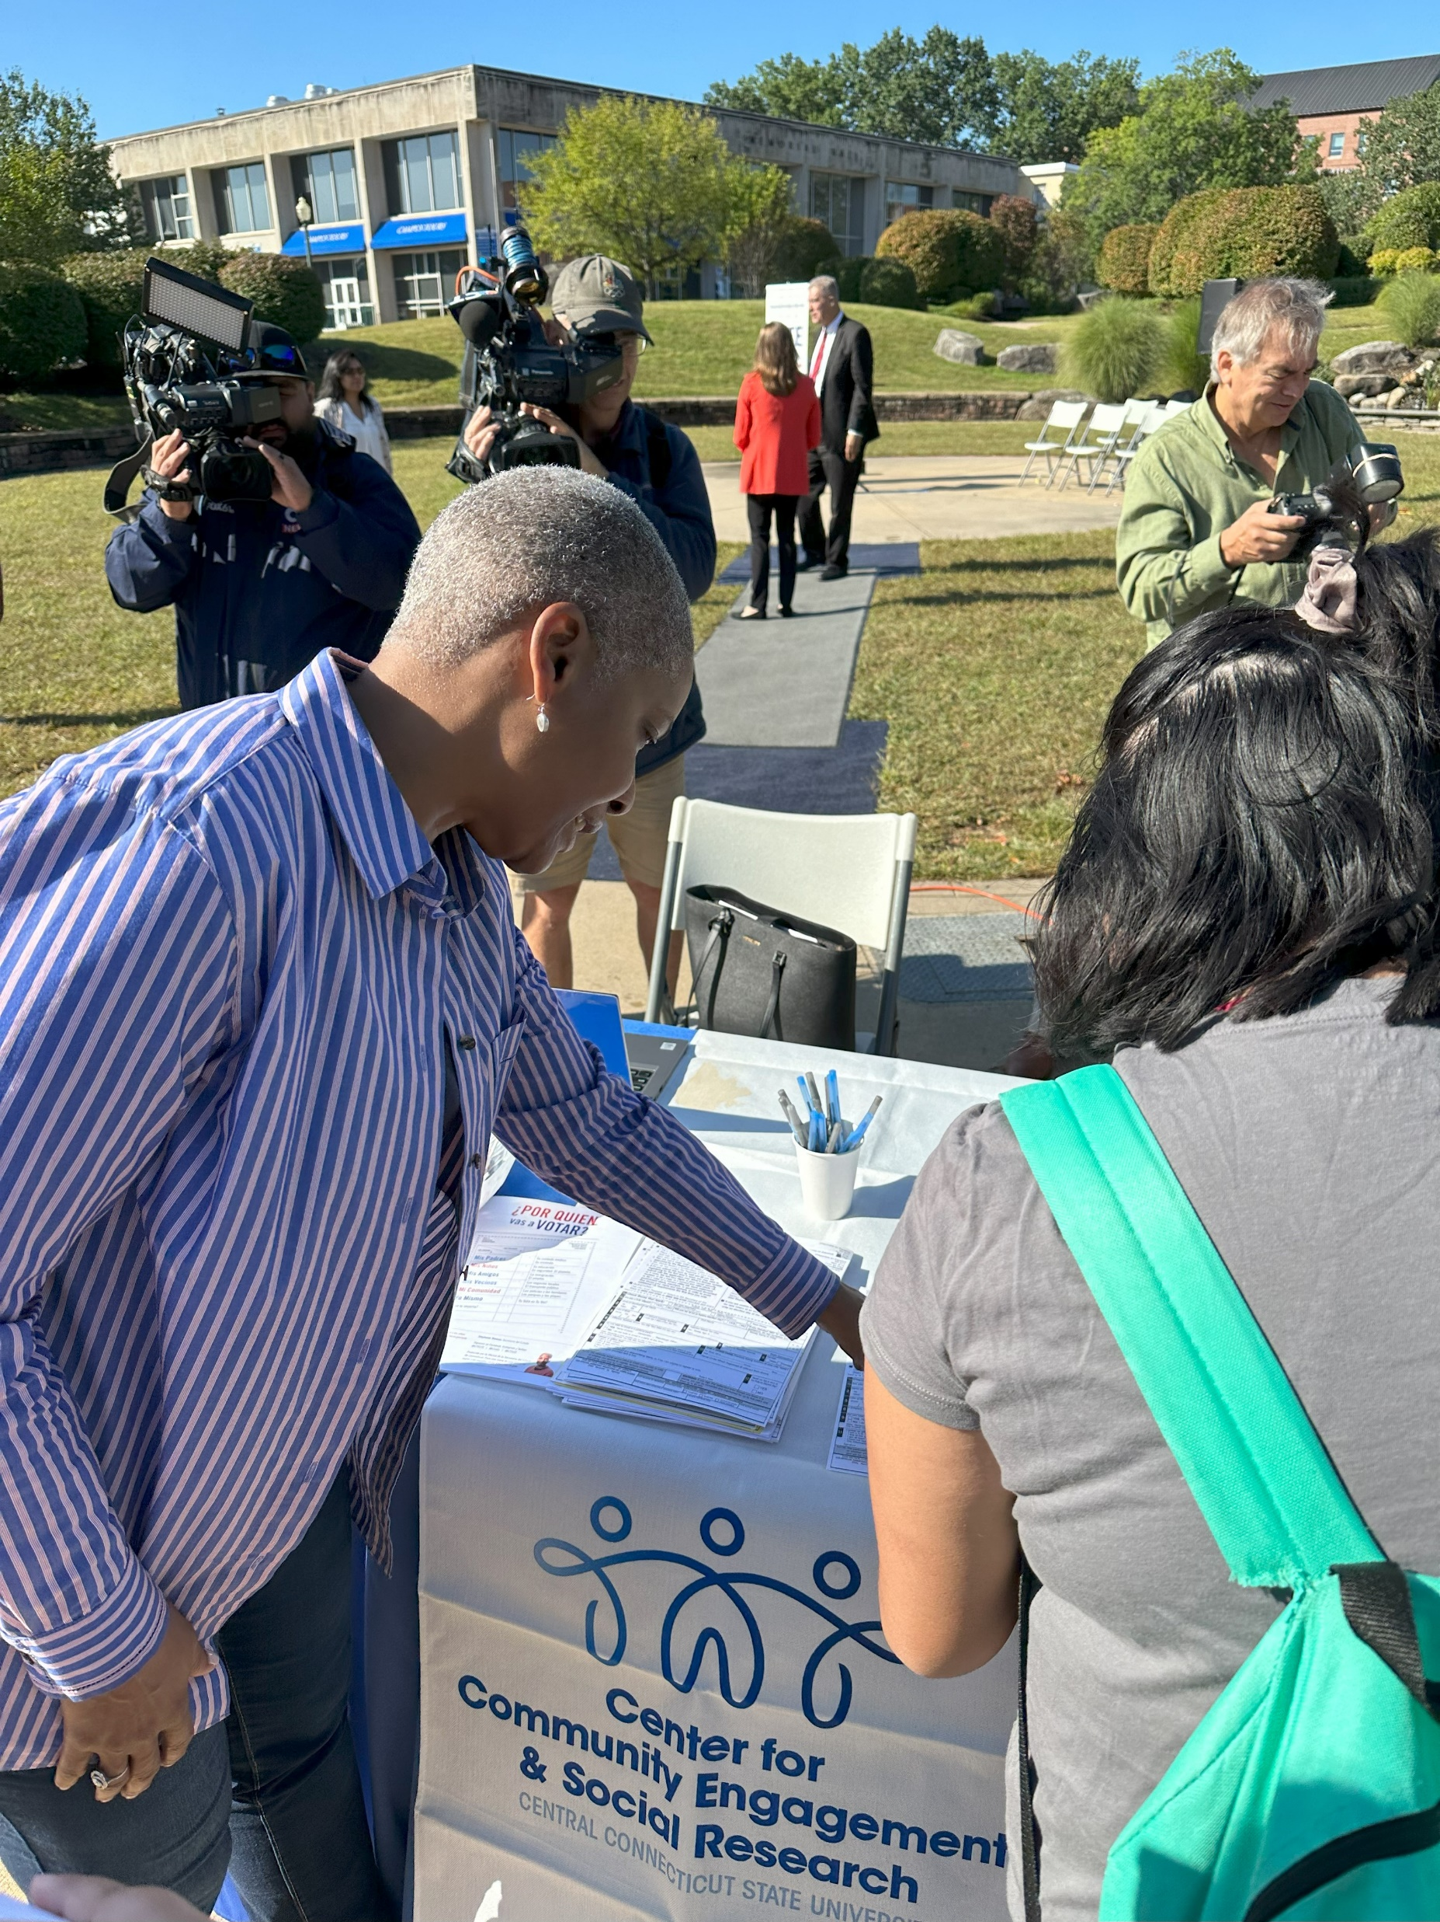
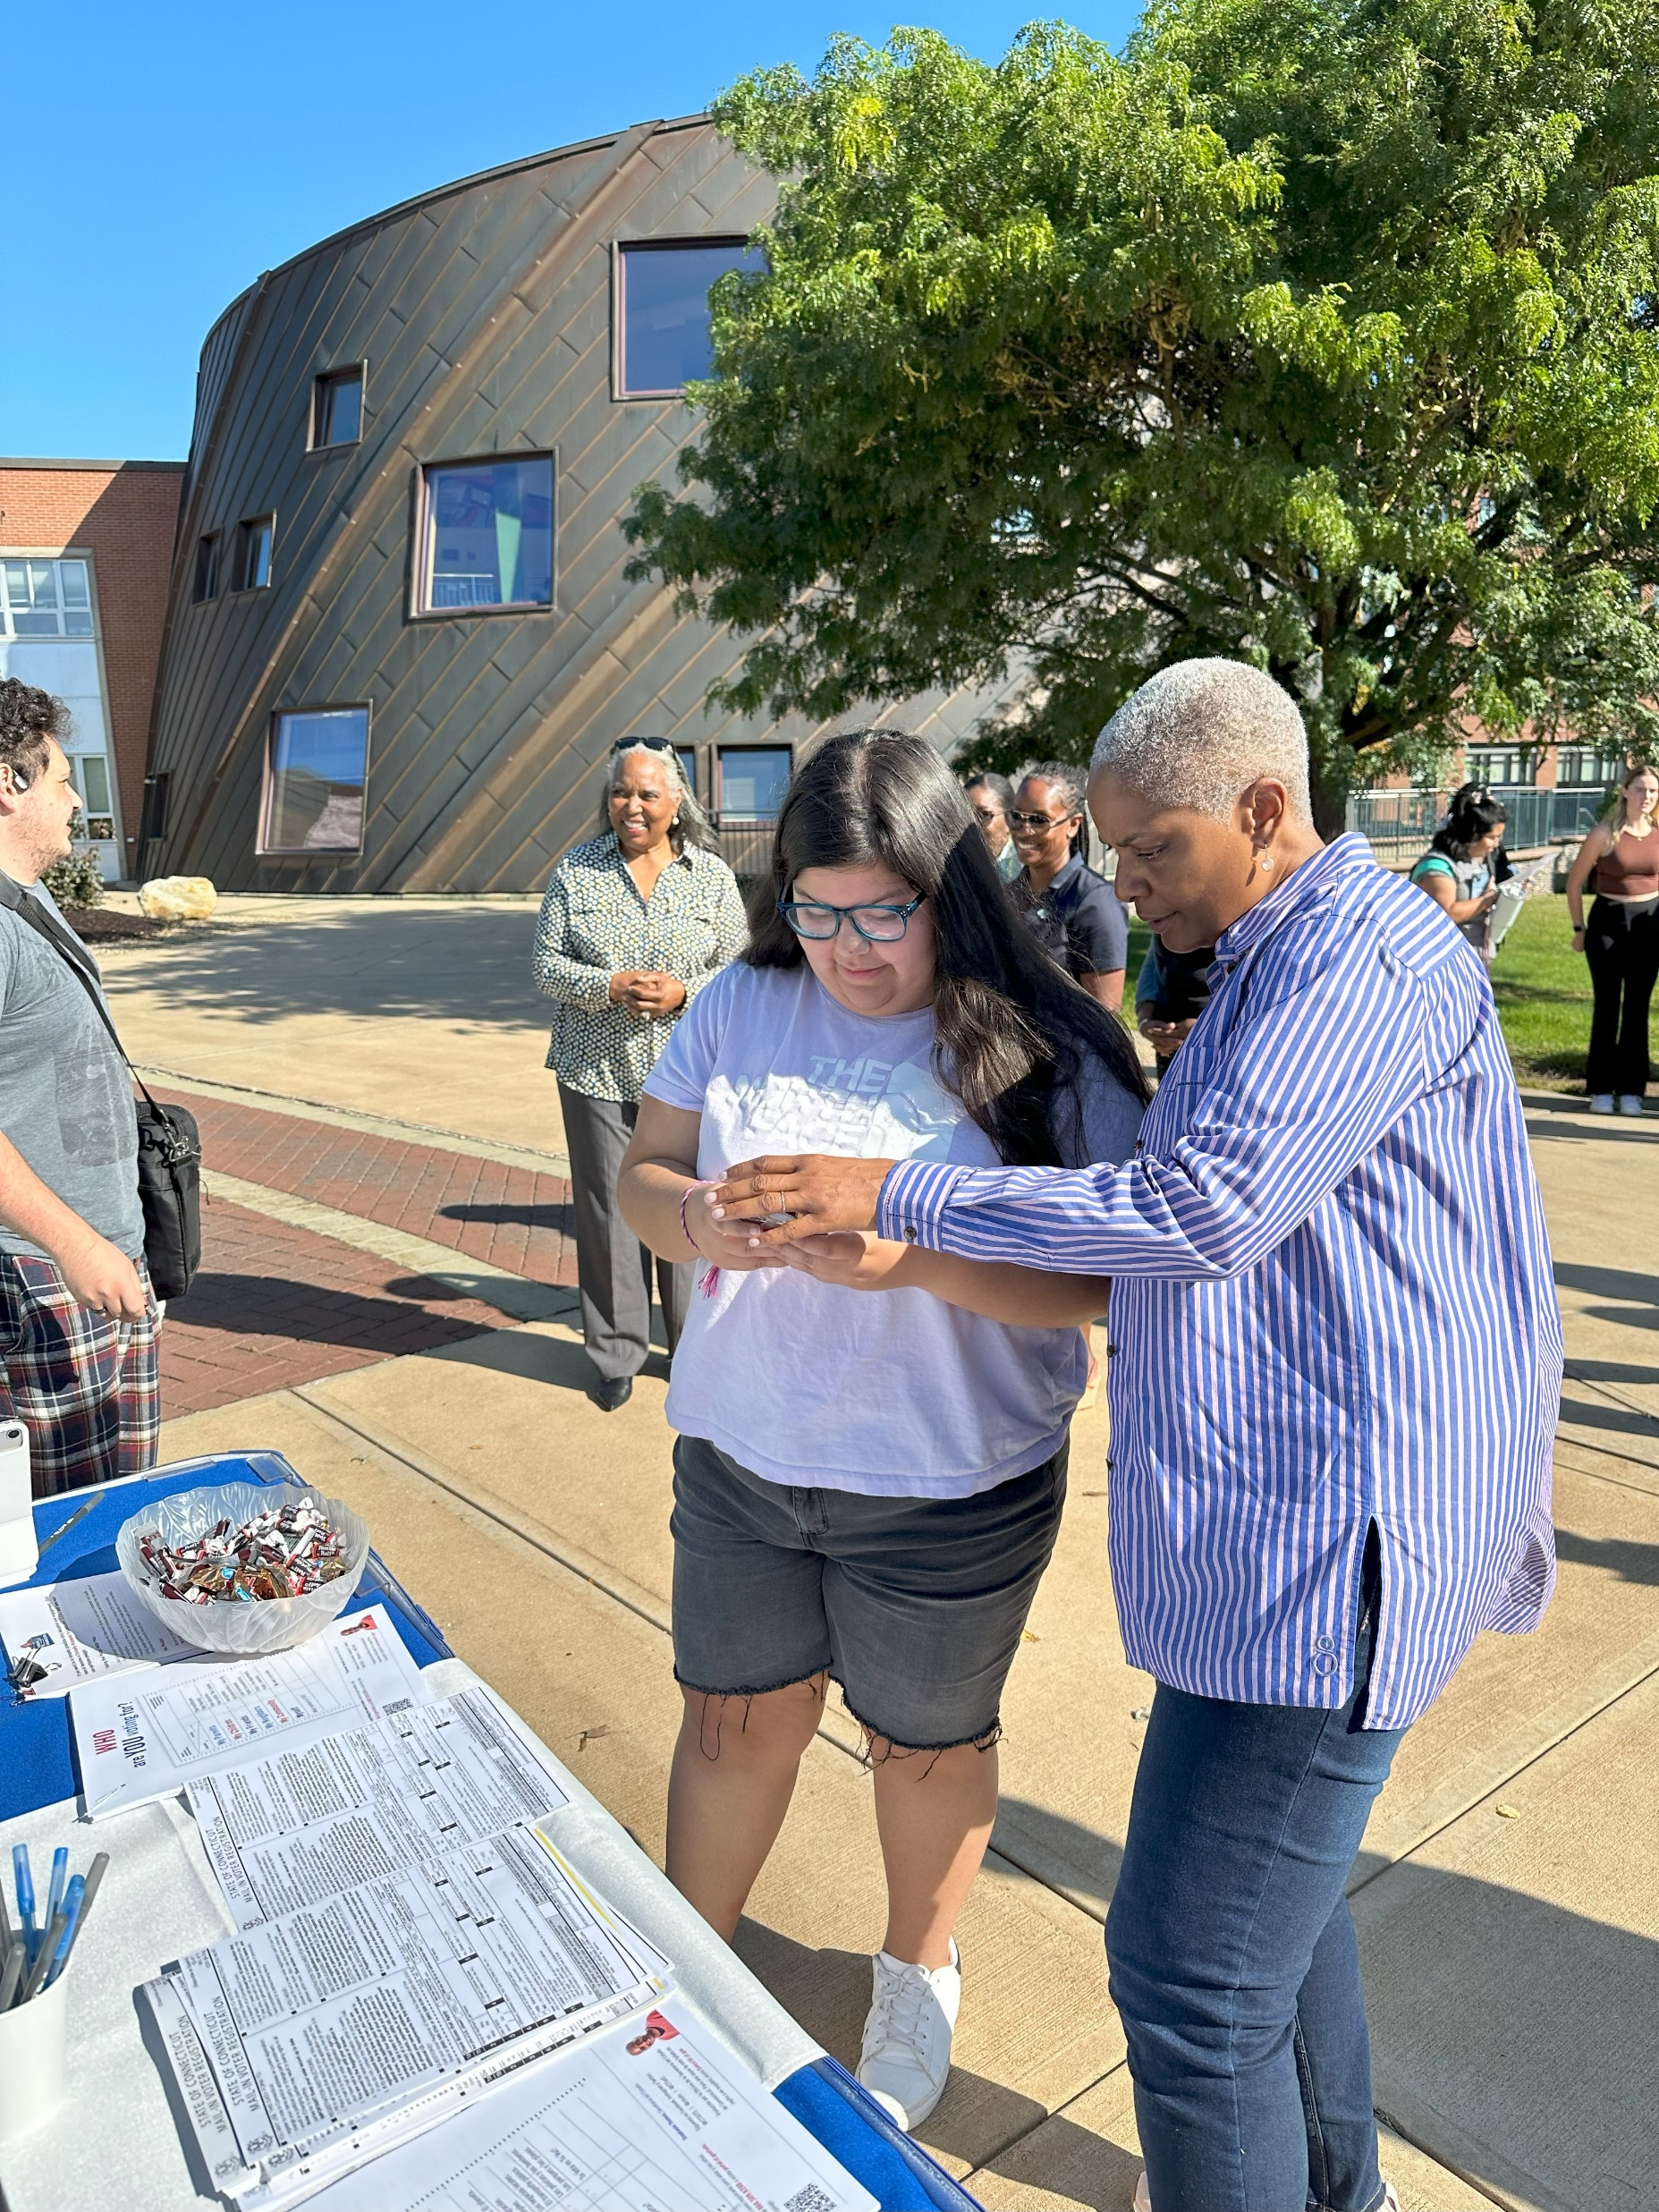
National Voter Registration Day (September 19)
20 College and University Campuses Across the State
College 101 Handout
Message to Register, Vote, and Engage
Encouragement to #voteLOCAL

Slide 3
2023 Primary Elections
26 Primary Elections
4 Recounts
3 Malfunctioning Tabulators
WE DID IT! THANK YOU!!

Slide 4
SOTS Updates
New Director of Elections!
Old and New CVRS/EMS
Requests for Early Voting Resources
Bonding Request for Tabulators
September 26th Special Session

Slide 5
Preparing for 2024
Nonpartisan Approach
Breaking Down Silos
Training
Planning
Practice Builds Muscle Memory

Slide 6
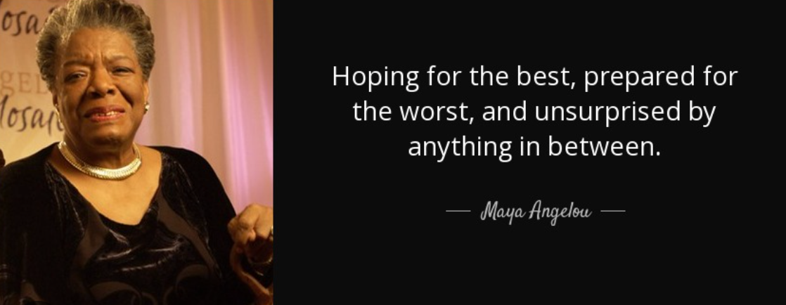
WE CAN DO IT!!!

Slide 7
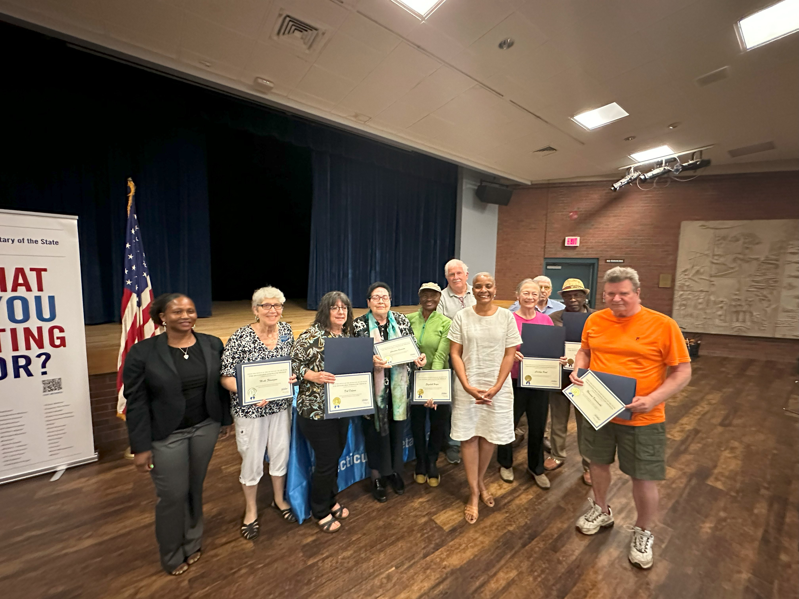
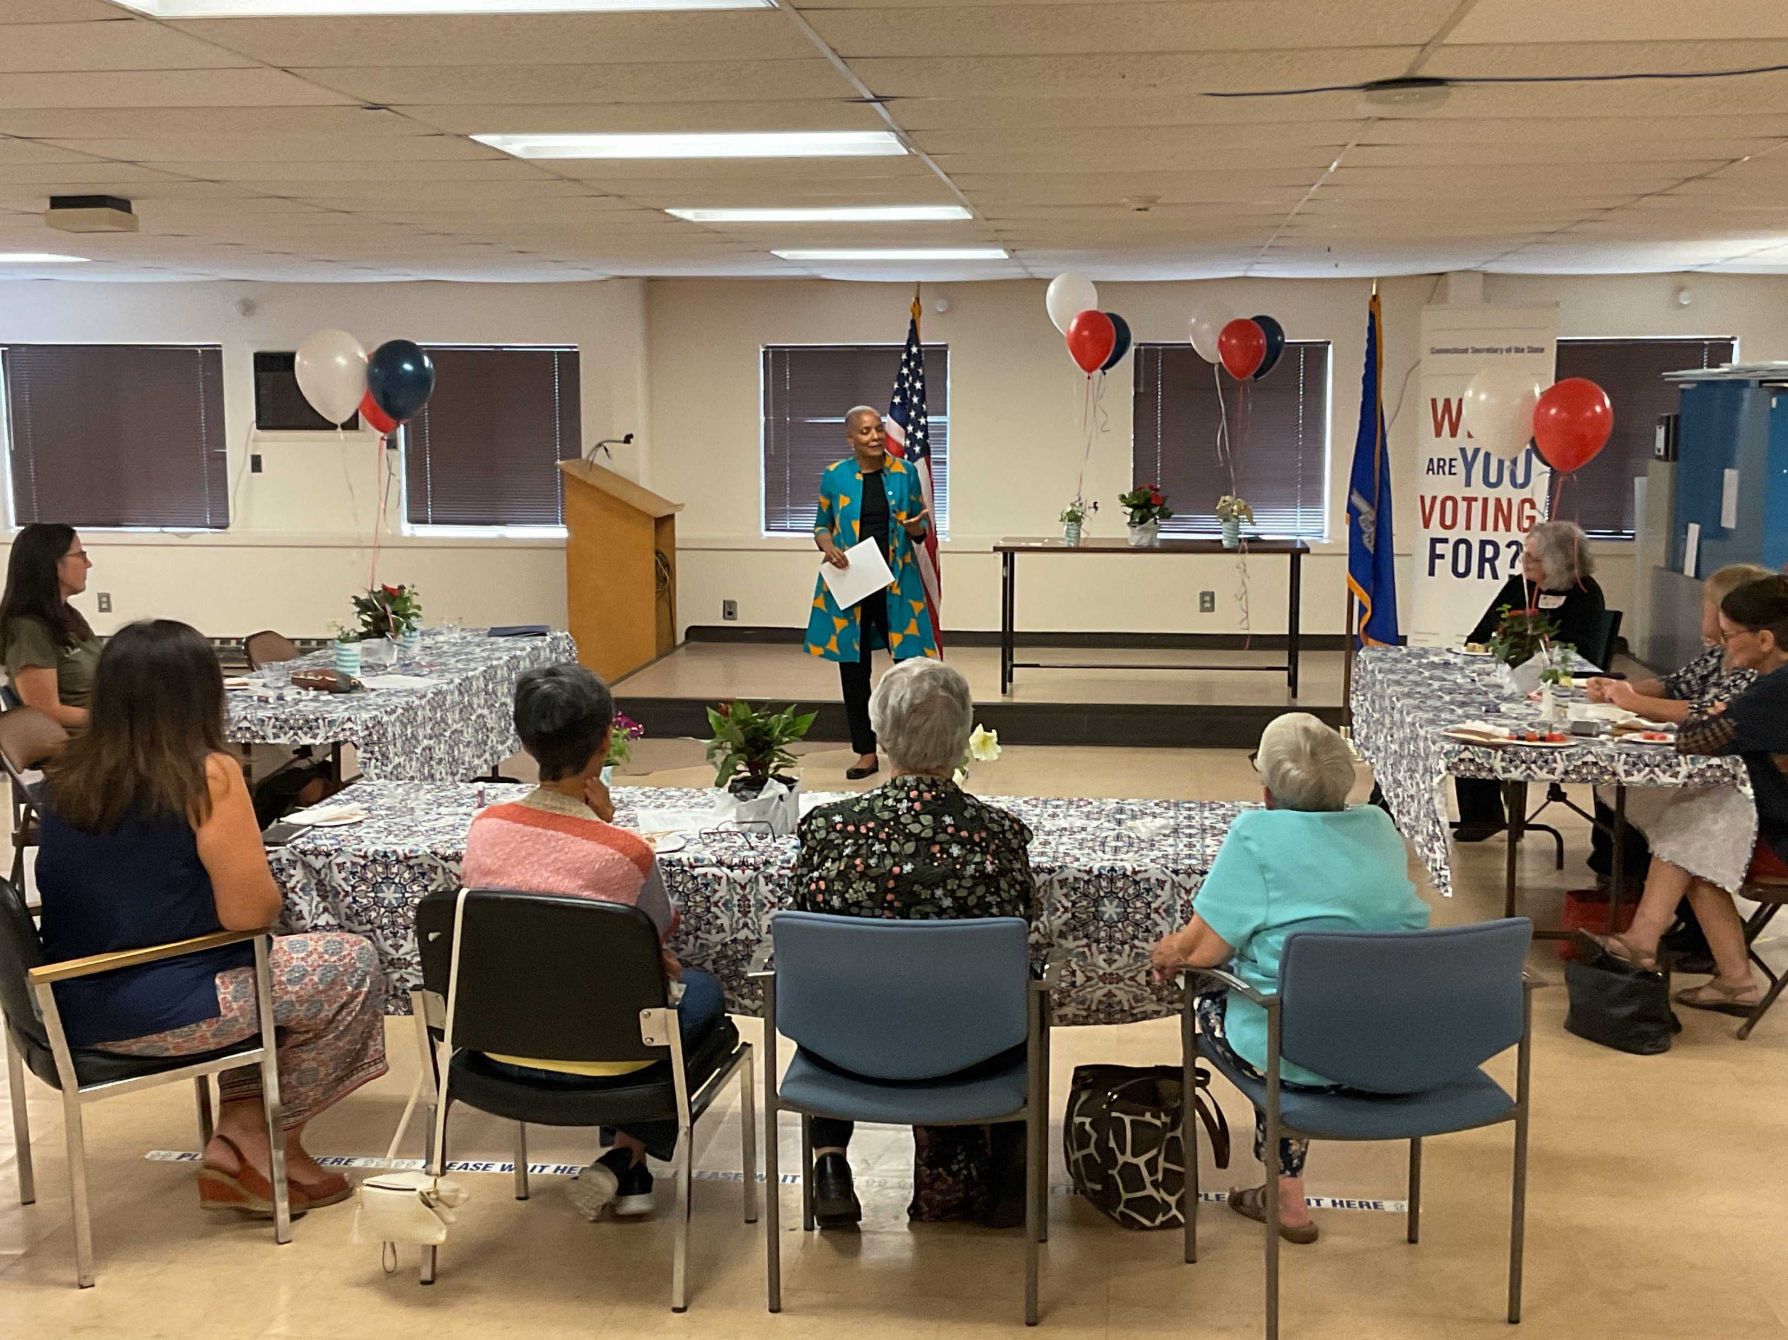
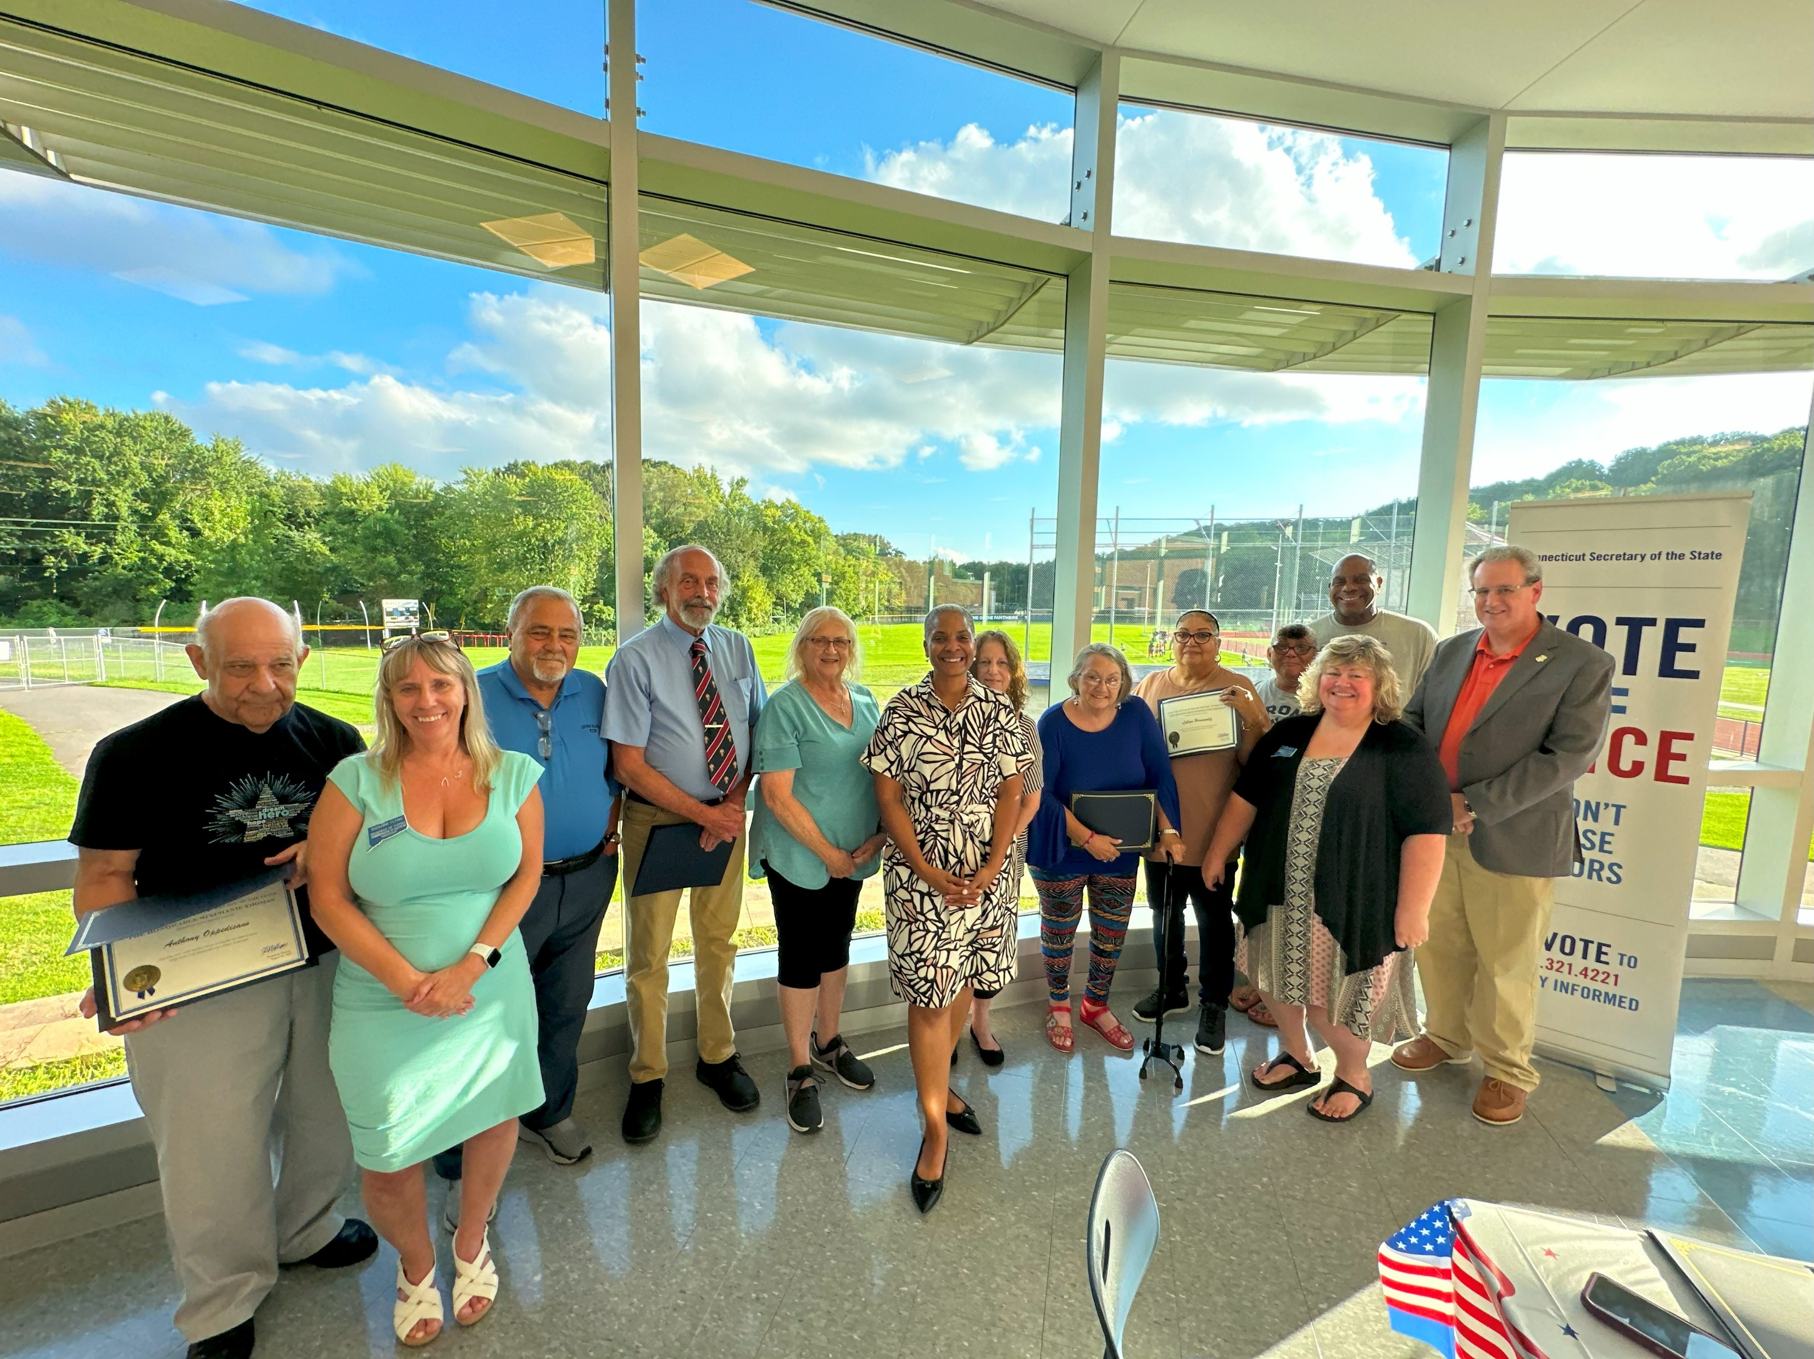
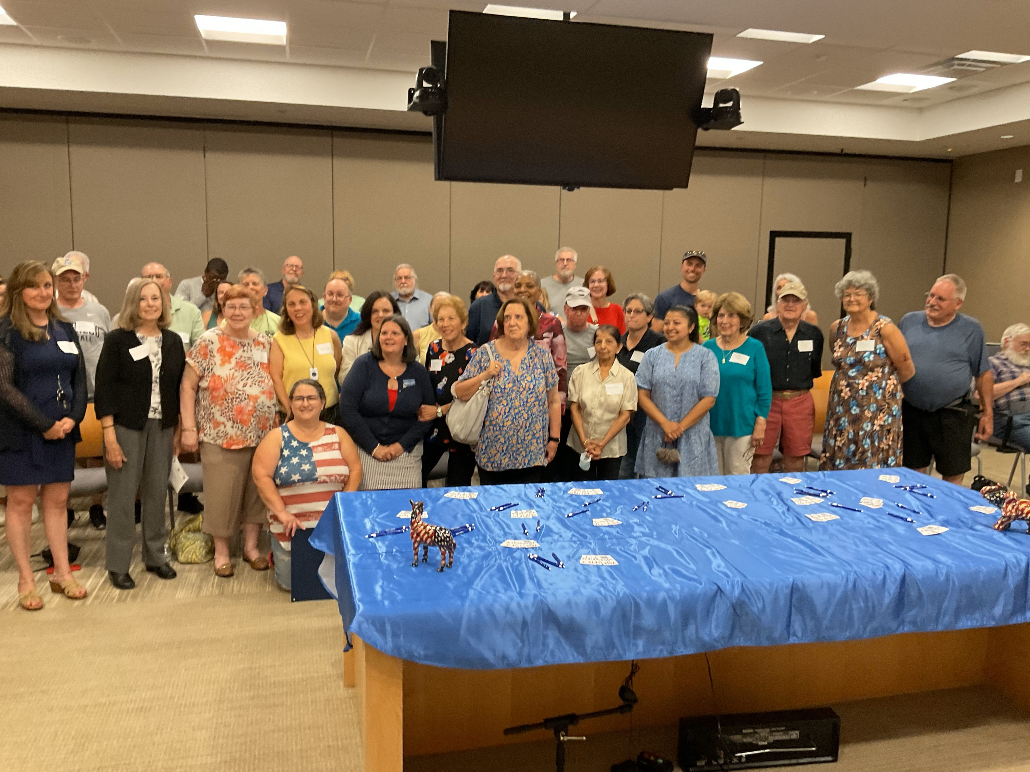
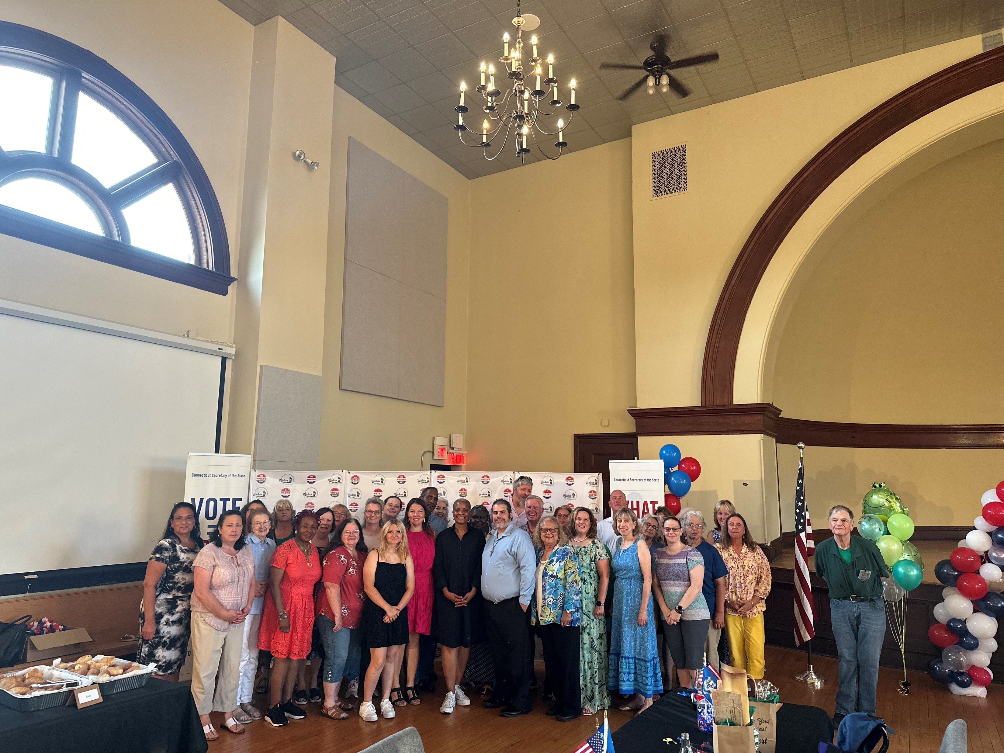
Sign Up to Host
a Poll Worker
Appreciation Event!
Email us at:
sots-events@ct.gov

Slide 8
Comprehensive Survey
49 Towns Returned!
Make Educated Guesses
Do Your Best; We Aren’t Holding You to It
DUE SEPTEMBER 25TH

