Slide 2
Elections Systems: Designated Critical Infrastructure
A unique designation that provides a basis for the Department of Homeland Security and other federal agencies to:
Recognize the importance of these systems;
Prioritize services and support to enhancing security for election infrastructure;
Provide the elections community with the opportunity to work with each other, the Federal Government, and through the Coordinating Councils;
Send a message of our intention to hold anyone who attacks these systems responsible for violating international norms.

Slide 3
Election Infrastructure Subsector Government Coordinating Council
Federal, state, and local government partners formed the Election Infrastructure Subsector GCC (EIS-GCC) and met for the first time in Atlanta in October 2017
The formation of the EIS-GCC was a milestone in multi-level government cooperation that bolstered election infrastructure security and resiliency.
The EIS-GCC:
Enables partners to leverage information sharing; cybersecurity and physical security products, resources, and capabilities; and collective expertise.
Consists of 27-members, 24 of which are state and local election officials.
Is led by a five-member Executive Committee which meets bi-weekly (Chair: DHS/CISA; EAC; a Secretary of State; a state Election Director; and a local Election Director).
Adopted a Sector Specific Plan in 2018. Sector priorities for 2019-2020 were approved on February 1, 2019.

Slide 4
Election Infrastructure Subsector Coordinating Council
Private sector stakeholders formed the Election Infrastructure Subsector Coordinating Council (EISCC) and met for the first time in February 2018
The EISCC:
Is led by a five-member Executive Committee.
Serves as the primary liaison between the private sector and government on election infrastructure security.
Facilitates information and intelligence sharing.
Coordinates with DHS and the EI-GCC to develop, recommend and review sector-wide plans and procedures.
Established an action plan complete with goals and priorities in February, 2019.

Slide 5
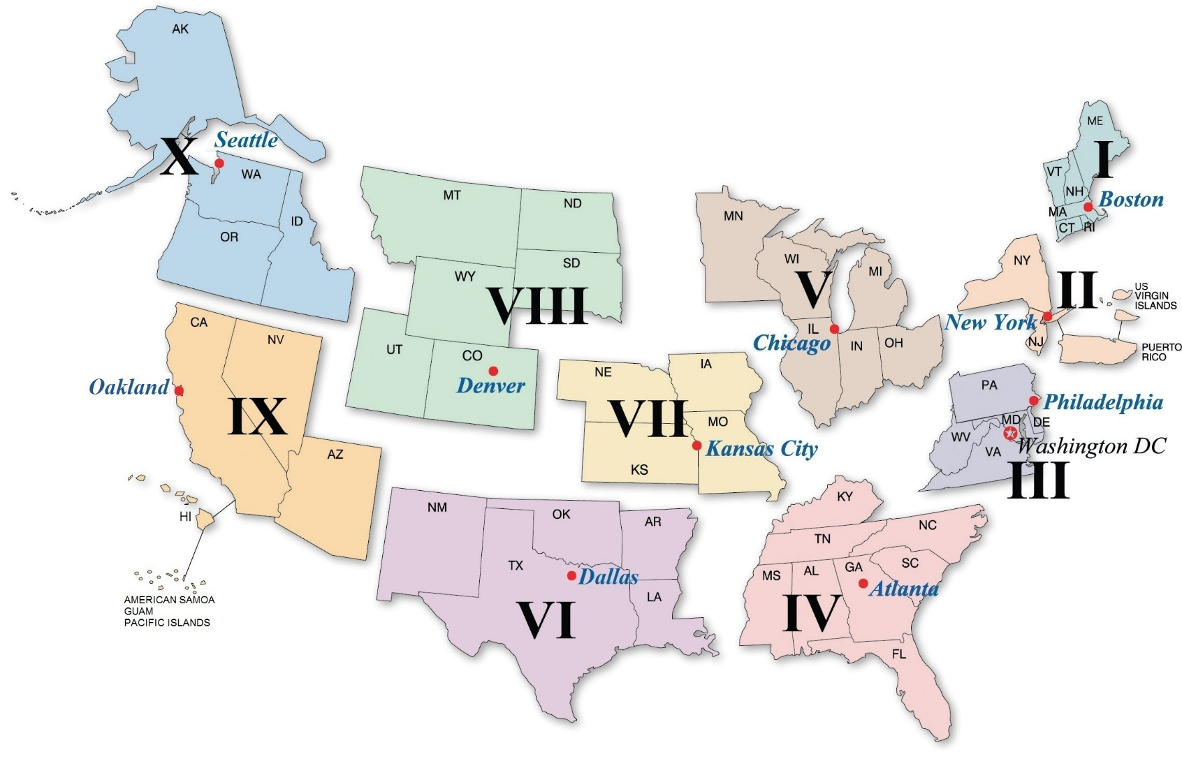
CISA Regions
Notes:
PSAs (Regular and Supervisory, excluding the Regional PSA) = Regions VII and X have 5 PSAs, while Region IV has 17
CSIs (Regular, Supervisory, and Senior) = Region I has 6 CSIs, while Region V has 28

Slide 6
CISA Regional Capabilities
Cybersecurity/information security expertise via your Regional Cybersecurity Advisor (CSA)
Physical security expertise via your local Protective Security Advisor (PSA)
Two-way Information Sharing between the field and CISA Headquarters
Scalable cyber and physical security assessments
Personal relationships between DHS and State/Local Election Officials

Slide 7
Progress in the 2018 Election Cycle
Establishment of the EI-ISAC
In February 2018, the EIS-GCC established the Elections Infrastructure ISAC, which is now the fastest growing ISAC ever
Funding Consideration Document
In May 2018, the EIS-GCC released a guidance document with potential short- and long-term funding considerations to support peers making decisions on how to spend election funding
Communications Protocols
In July 2018, the GCC issued a set of voluntary Communications Protocols to improve the efficiency and effectiveness of information sharing between Election Information Stakeholders
New Trainings and Assessments
Led by feedback from election officials, DHS now offers online “IT Management Training for Election Officials” and Remote Penetration Testing
National-level Election Security Tabletop Exercise
In August 2018, DHS hosted a three day tabletop exercise with 44 states, the District of Columbia, and 10 Federal agencies
Classified Briefings
Classified information was shared on several occasions, pushing more threat information to this sector than ever before. The most recent classified briefing was in February 2019.
Election Day Situation Room
On Election Day, DHS hosted the National Cybersecurity Situational Awareness Room. This online portal for state and local election officials and vendors facilitated rapid information sharing and provided election officials with virtual access to the 24/7 operational watch floor of the NCCIC

Slide 8
Resources for State and Local Election Officials
Vulnerability Scanning
A scanning of Internet-accessible systems for known vulnerabilities on a continual basis. As potential issues are identified, DHS notifies impacted customers so they may proactively mitigate risks to their systems prior to exploitation. Conducted remotely and fully automated.
Remote Penetration Testing
Utilizes a dedicated remote team to assess and identify vulnerabilities and work with customers to eliminate exploitable pathways. The assessment simulates the tactics and techniques of malicious adversaries and tests centralized data repositories, externally accessible assets, and web applications.
Phishing Campaign Assessment
Measures the susceptibility of an organization’s staff to social engineering attacks, specifically email phishing attacks. The assessment takes place during a six-week period. An assessment report is provided two weeks after its conclusion. The assessment report provides guidance, measures effectiveness, and justifies resources needed to defend against and increase staff training and awareness of generic phishing and spear- phishing attacks.

Slide 9
Join the Election Infrastructure ISAC
The EI-ISAC is a dedicated resource that gathers, analyzes, and shares information on critical infrastructure and facilitates two-way cybersecurity threat information sharing between the public and the private sectors.
The EI-ISAC supports the election community through:
24 x 7 x 365 network monitoring
Election-specific threat intelligence
Threat and vulnerability monitoring
Incident response and remediation
Training sessions and webinars
Promotion of security best practices

Slide 10
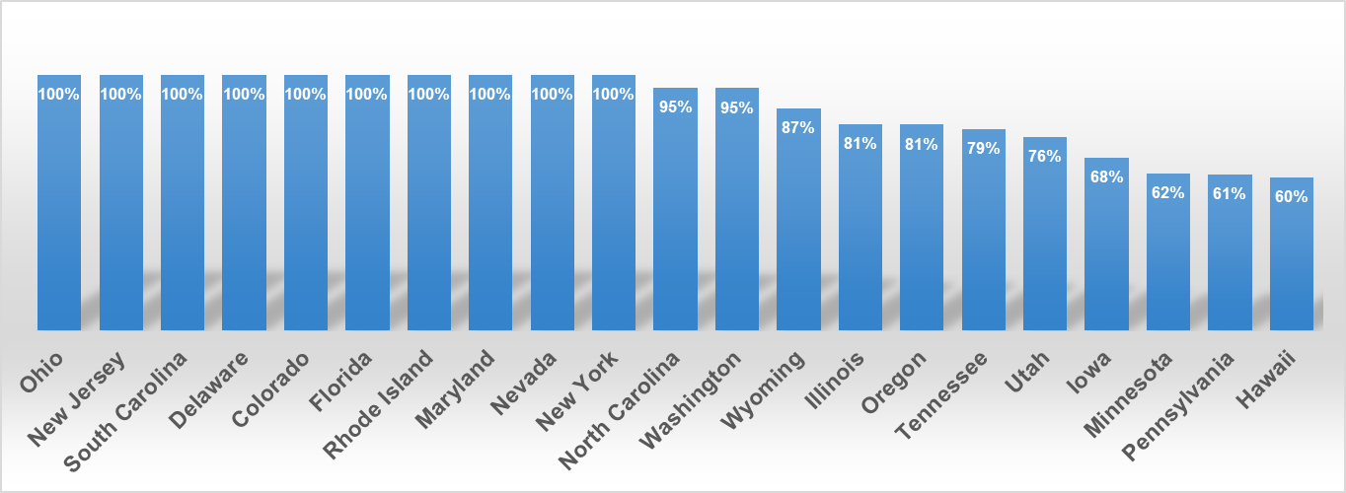
Positive Relationships – By the Numbers
EI-ISAC Membership - 1554
50 states and 4 territories
1476 local election offices
7 associations
14 election vendors
Albert Sensors - 140
47 states and 1 territory
92 local election offices
States with a High Level of Local EI-ISAC Membership

Slide 11
Election Infrastructure Security – Adoption of Services
SERVICE | Total
Cyber Resilience Review (CRR) | 24
External Dependencies Management Assessment | 18
Cyber Infrastructure Survey (CIS) | 19
Cyber Hygiene Scanning (CyHy) | 150
Hunt | 25
Risk and Vulnerability Assessment (RVA) | 40
Remote Penetration Testing (RPT) | 25
Phishing Campaign Assessment (PCA) | 10
Election-related Exercises | 32
43 States have utilized at least one DHS cybersecurity service
30 States have utilized at least two DHS cybersecurity services
14 states have utilized three or more DHS cybersecurity services
6 states have leveraged five or more DHS cybersecurity services
Services updated 4/2/2019

Slide 12
Top Recommendations Provided Across All EI Assessments
Mitigate Internet Vulnerabilities in a timely manner
Recommend that EI Subsector entity managers mitigate all internet-accessible high and critical severity level vulnerabilities within 30 days. Vulnerabilities with lower severity levels should be reviewed and either mitigated, or the associated risk formally accepted, within 60 days.
Strengthen Password Policy and Auditing Processes
Recommend the use of multi-factor password technology. Entities should perform regular audits of their password policy. Password best practices include ensuring that default passwords are never used in production, that strong passwords are required and used, and that administrators use encrypted password vaults.
Implement Network Segmentation
Internal network architecture should protect and control access to the entity’s most sensitive systems. Recommend that user workstations should be less trusted and connections to external networks should be isolated, controlled, and monitored.
Follow Cybersecurity Best Practices
EI Subsector entities should follow established enterprise network best practices for IT infrastructure, including the implementation of a strong patching methodology for operating systems and third-party products.
Replace Unmaintainable Equipment
All EI Subsector equipment should be maintainable with current security patching. Exceptions should be minimized and isolated.

Slide 13
CISA Cybersecurity 101
Matt Masterson
Senior Cybersecurity Advisor
Department of Homeland Security
Matthew.Masterson@hq.dhs.gov
Geoff Hale
Director, Election Security Initiative
Department of Homeland Security
Geoffrey.Hale@hq.dhs.gov

